Slide 1


Overview of SacPAS:
Central Valley Prediction & Assessment of Salmon and other fishes
Jennifer L. Gosselin, Susannah Iltis, and W. Nicholas Beer
Notes:
We'd like to provide an Overview of SacPAS to help bring everyone on the same page. Many folks here have not visited the SacPAS website before, many other folks here are seasoned users and co-developer of tools with us. We hope that you will learn something new in terms of specific tools available and in our process.
My co-presenters are Susannah Iltis, our Web Computing Specialist, and Nick Beer, one of the researchers at Columbia Basin Research.

Slide 2




Presentation Goals
AWARENESS
of SacPAS tools available
APPROACH
of how we provide SERVICE
Kickstart at workshop
for
FEEDBACK
and
COLLABORATION
Photos and icons from Public Domain; purchased iStock; unsplash; and thenounproject.
Notes:
In terms of presentation goals, we hope that by the end of this presentation, you would have gained:
- increased awareness of SacPAS tools available,
- a better understanding of how we approach the work that we do, and
- concepts and specific examples that will help kickstart this workshop for lively discussions, feedback and collaboration later today and into the future.

Slide 3



Outline
I. Data Queries & Alerts
II. Work Groups & Teams
III. Models: survival, migration, etc.
CBR History & Philosophy
Sneak peak of new SacPAS website
Recap of presentation
to setup for:
  Open Discussion
  Office Hours
Notes:
I will cover a bit about how Columbia Basin Research started, share some recent developments on the CBR website, and a sneak peak of what the SacPAS website will look like next year.
Susannah Iltis will then present on the next two sections: 1. Data Queries & Alerts and 2. Work Groups & Teams.
Nick Beer will present on the section on modeling tools.
And then I’ll give a quick recap of the presentation. And again we hope that what you hear will lead into the Open Discussion and Office Hours sessions later today.

Slide 4
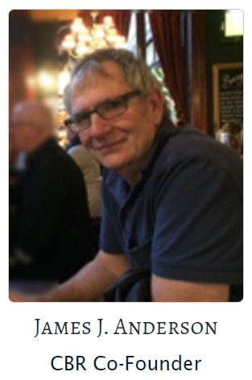
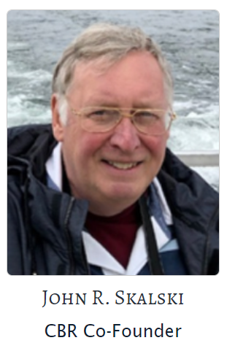
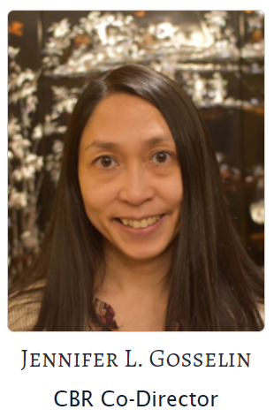
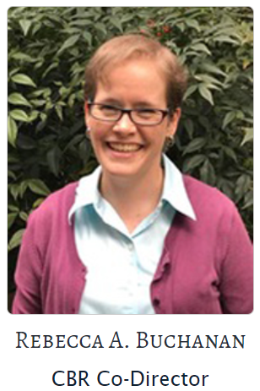
History & Philosophy of CBR
Three decades ago,
Prof. Anderson and Skalski
started Columbia Basin Research
Provide practitioners easy access to data, info, and analytical methods, for in-season fish & river management meetings.
Anderson /
Gosselin Lab
Skalski /
Buchanan Lab
That is what we continue to strive to provide:
  access to data,
  value-added visualizations,
  statistical & modeling tools
  customized to the needs of the users.
Notes:
Let's take a moment to backtrack a little bit and cover the beginnings of CBR.
Professors Anderson and Skalski started CBR three decades ago.
[CLICK] The main goal was to provide practitioners, like fish and river managers, policy makers, scientists, easy access to data for in-season management, decision-making, and research.
Over 3 decades ago, they noticed that some of the in-season management meetings occurred on a weekly basis and information was being put together somewhat manually by folks for each meeting. As well, some data that was being made public, was essentially only made available in a small rolling window. CBR started to automate retrieval and store public data - for some of their own modeling work and also thus wanted to make the data available for public access.
Therefore, the real-time and historical data, that was being mirrored, integrated, and centralized at CBR, was made available for public access. And the services and products from CBR grew from there, with additional development of analytical tools.
[CLICK] That's what we continue to strive to provide. Reducing unnecessary effort on data wrangling so that folks can focus more efficiently on insight and knowledge about the systems they work in.
With Prof. Anderson and Prof. Salski retired, Dr. Rebecca Buchanan and I, aim to CONTINUE providing:
- access to data,
- value-added visualizations of relevant metrics and integrated data, and
- statistical & modeling tools,
- that are customized to the needs of the users.

Slide 5

DART: secondary data repository, centralized and integrated data sets
PSMFC
PIT tag
NOAA
Ocean
Tribes
Smolt Trap
Adult passage
State agencies
Smolt Trap
Adult passage
PUDs
Project data
Adult passage
USACE
Project, Water Quality
Salmon passage
USGS
Streamflow,
Temperature
FPC
Smolt Index
Hatchery Release
Transportation
DATA
PREPARATION
Database management
Data analysis
& visualization
Web & tools development
PRODUCTS & SERVICES
DART
Data Access in Real Time
Archiving
& Integration
Queries
Customized Requests
Predictions
Notes:
The CBR website started in the early 1990s and by 1996, we had the DART website. DART standing for Data Access in Real Time.
DART is a secondary data repository with centralized and integrated data from numerous other sources.
CLICK
I’ll describe what DART is through this flow chart diagram going from data acquisition, to preparation, and then to the products and services that DART offers.
CLICK
We mirror data from many sources, including federal, tribal, state governmental agencies and other entities, to aggregate and integrate data into a centralized location, accessible to the public in real-time.
CLICK
Our database administrator, web specialist, and CBR researchers prepare the data for analysis and online tools. And these are created with as much foresight as possible and in collaboration with data owners and stakeholders.
CLICK
The products and services that DART provides are mainly
archiving and integrating data sets,
developing query tools for customized data downloads and data visualizations.
More specialized requests, and
other online predictions tools.
As you may have noticed, this is very similar to what SacPAS offers.
Over the decades, we have developed many different tools, as well, we continue to update and evolve.

Slide 6
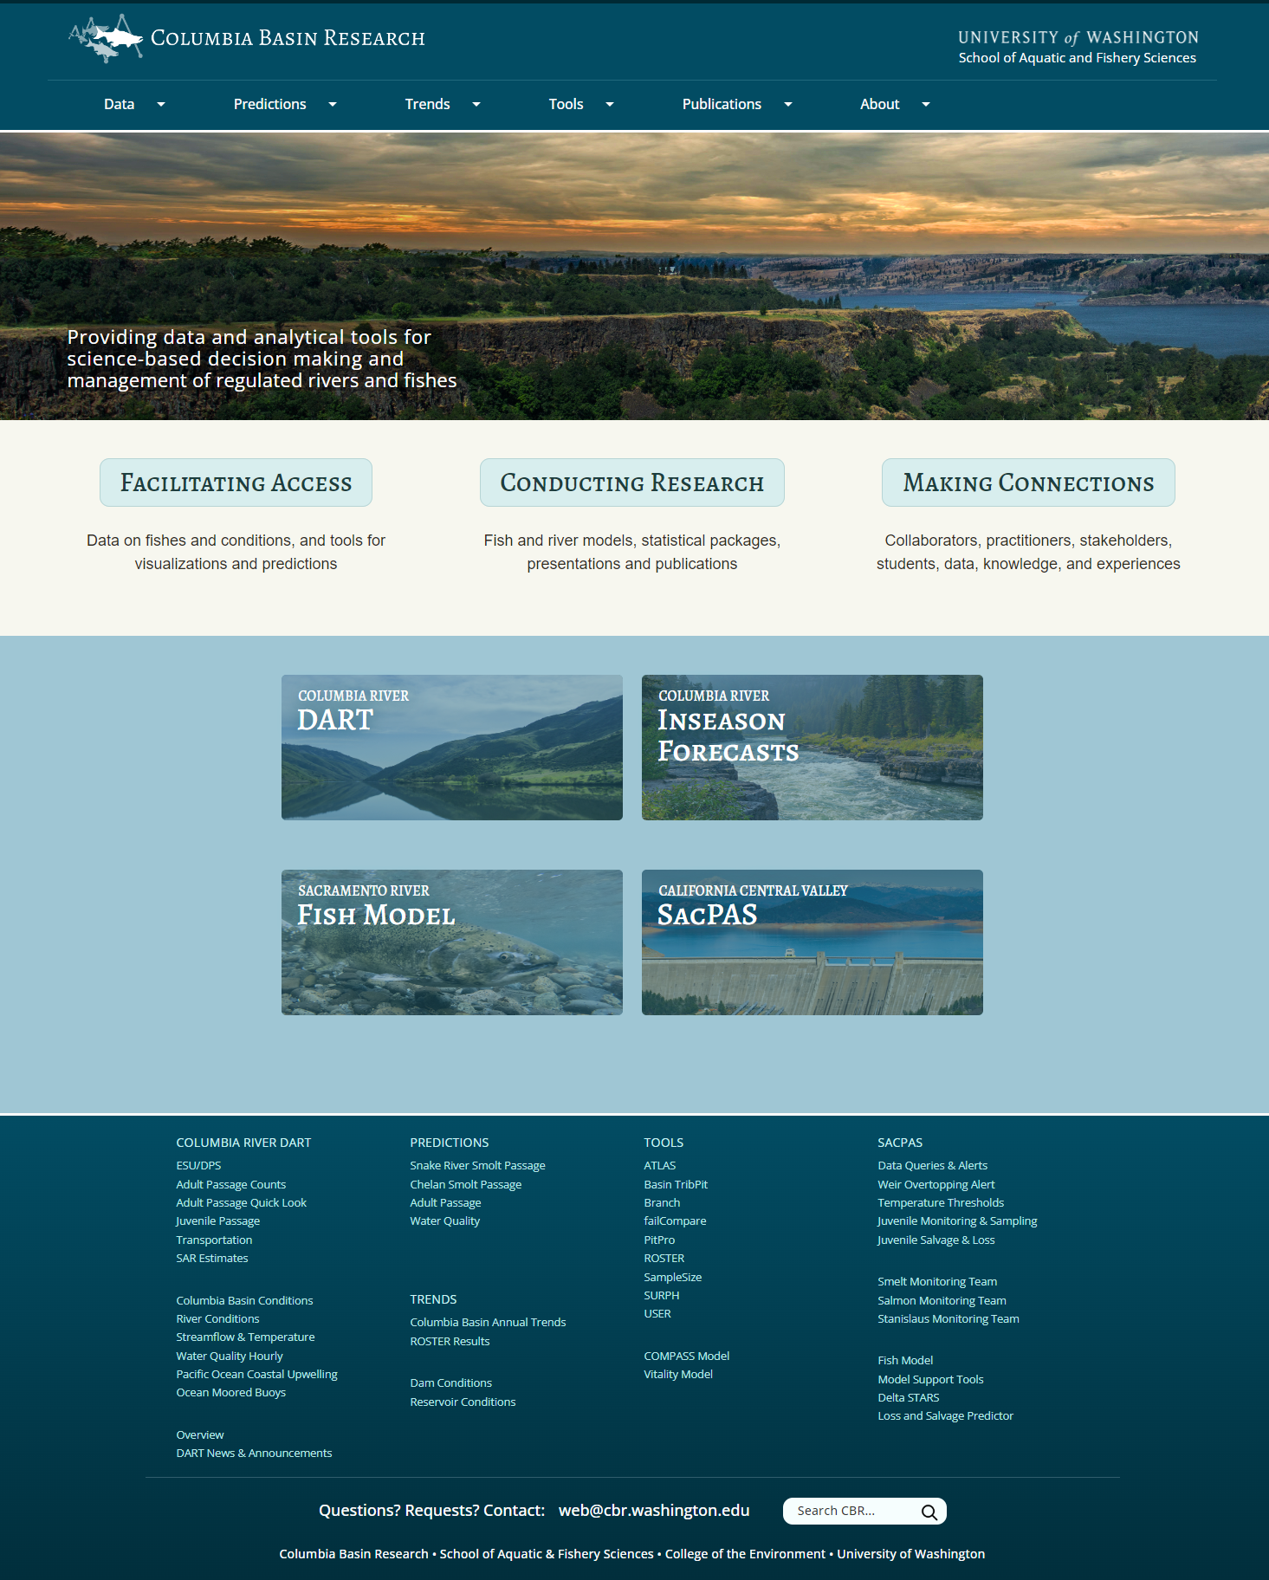

https://www.cbr.washington.edu/
Notes:
With all of the tools developed over the decades,
… we needed to do some gardening and pruning to help provide accessibility to our users. Last July we updated our CBR website.

Slide 7
SacPAS website updates in progress…
Notes:
Along with these changes to the CBR website, we are working on updating the SacPAS website too.

Slide 8
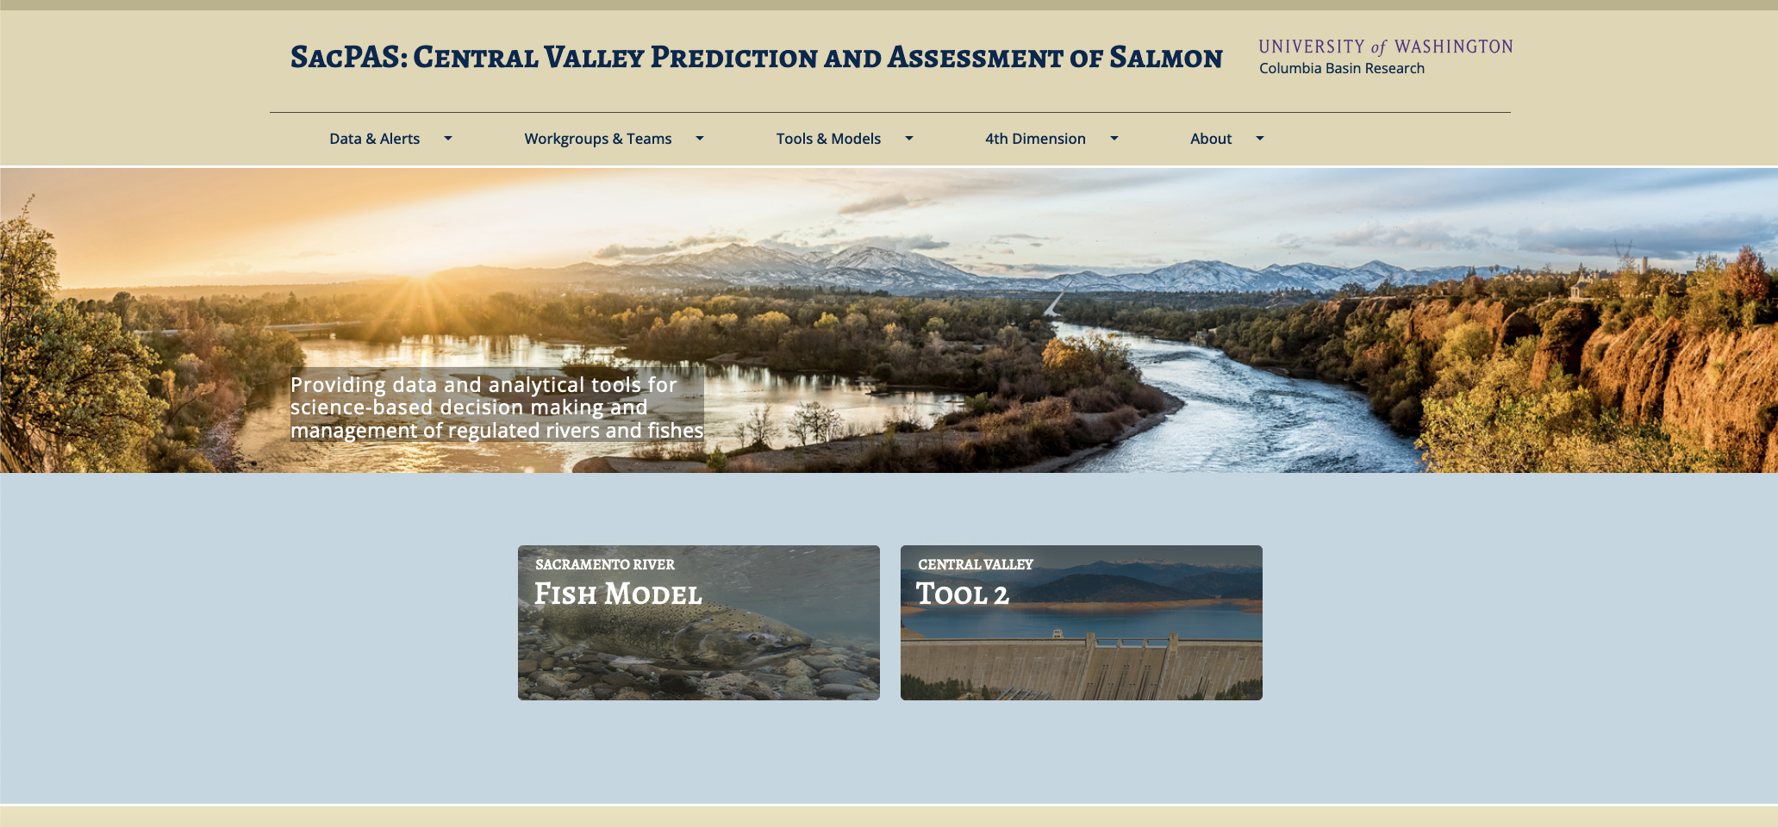
Notes:
The SacPAS website will be updated in a similar way to our CBR website.

Slide 9
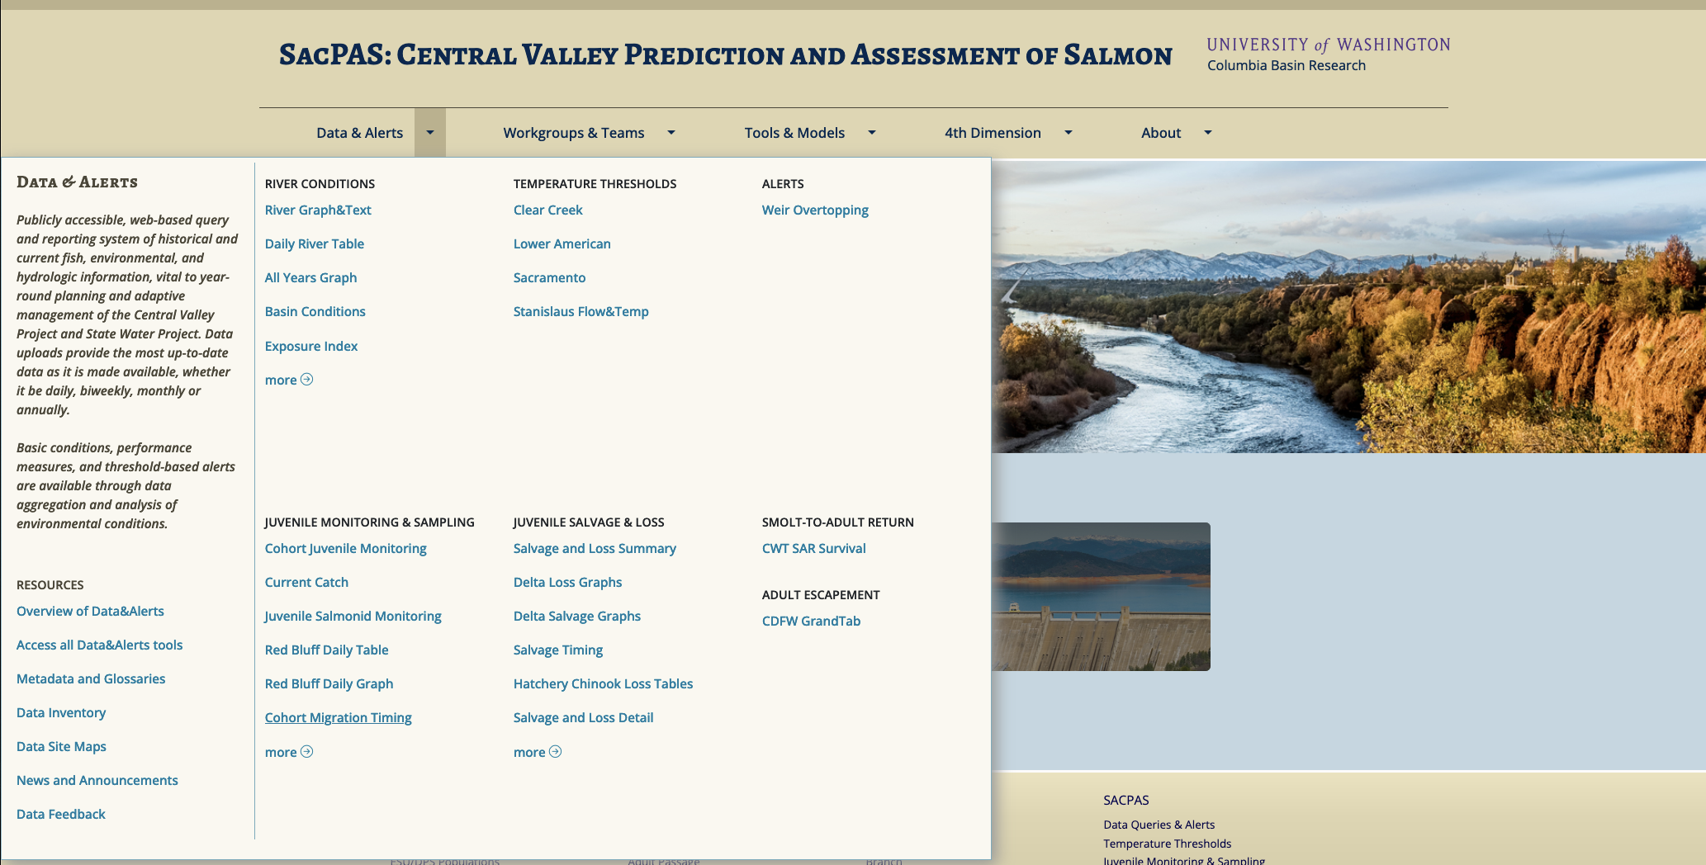
Notes:
It will have a MegaMenu to provide more organization and easier access to the tools. Here is the MegaMenu drowndown for Data & Alerts.

Slide 10
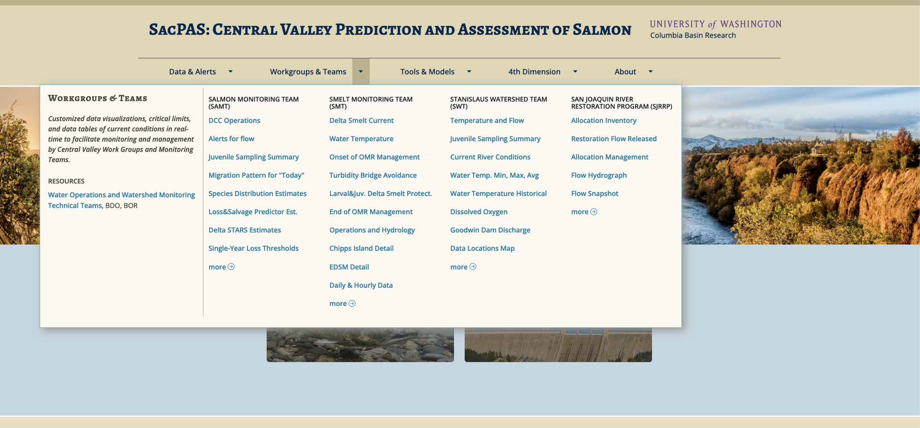
Notes:
For work groups and teams

Slide 11
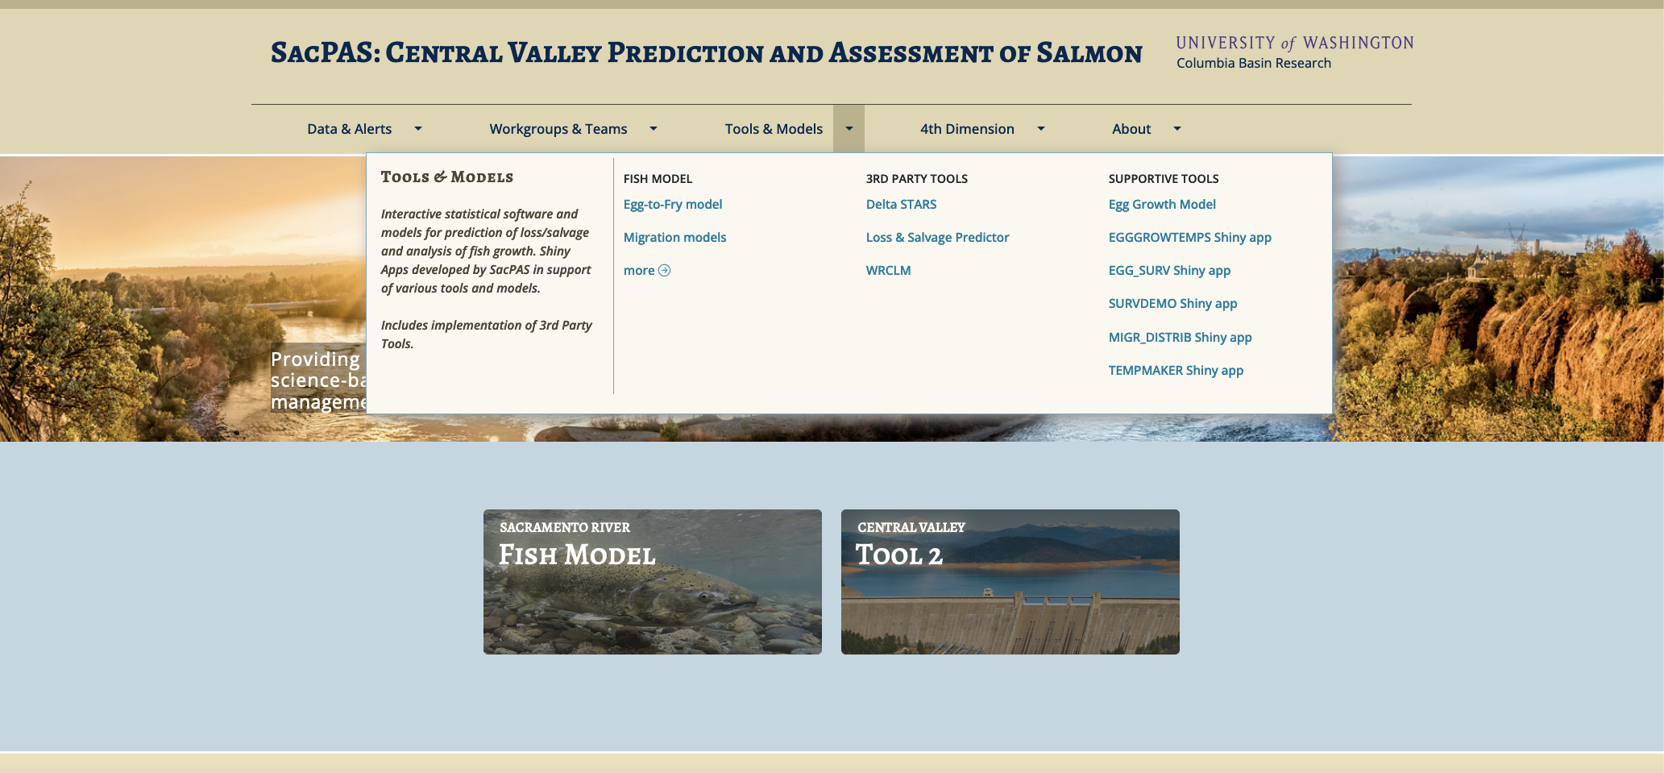
Notes:
And for for tools and models

Slide 12
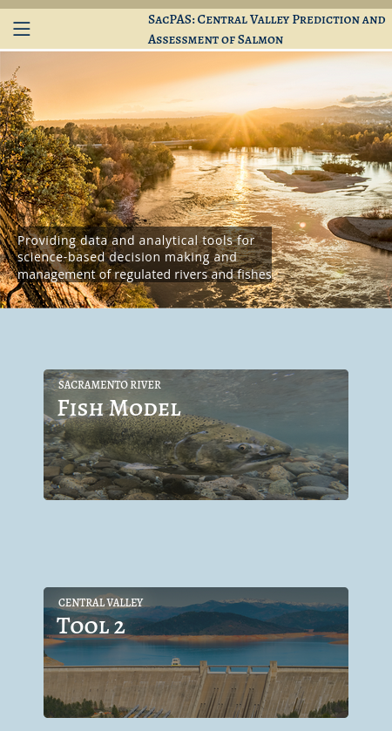
Mobile version
in development
Notes:
We also have a mobile version in development

Slide 13
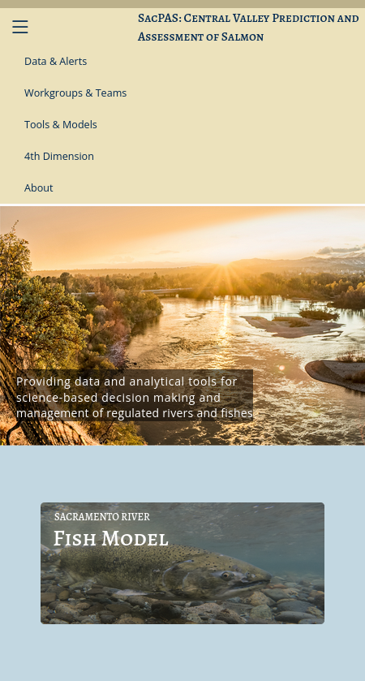
Notes:
That will provide an accordion style menu

Slide 14
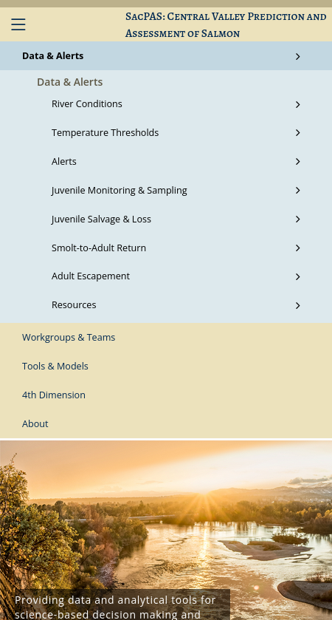
Notes:
Where you can see the subcategories under Data & Alerts

Slide 15
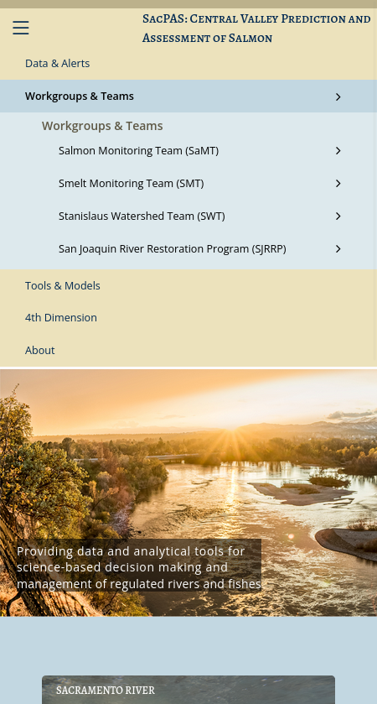
Notes:
And Workgroups & Teams, for example.
Before I pass the presentation on to Susannah to go over some online tools…

Slide 16

Assistance in accessing data and addressing knowledge-action gaps
Data collection
Data Access
Knowledge
Actions
Goals
Notes:
I would like to describe a bit more in general terms what SacPAS offers.
On this spectrum from data collection to actions and goals, we, the SacPAS team, try our best to keep a perspective of the big picture [CLICK] as we work in this space [CLICK], which helps link Data Collection to Data Access to Knowledge. We can most directly assist in the work that takes place in this space, as well as provide products and services that help with the work involved with decision making on actions, here in this space [CLICK].
We understand that the work involved with access to data and knowledge is not a simple, straightforward process as symbolized by these two straight arrows, but is [CLICK] an interconnected, complex, rich network of processes on many different dimensions. Therefore, we aim to provide not just access to raw data, but value-added products that are customized and thus useful and relevant to users and practitioners.

Slide 17
Developing with Design Thinking &
Human-Centered Design in mind
SacPAS Tools & Services:
1. Understand & empathize
2. Explore & Ideate
3. Test & Implement
Values
Context
Culture
Worldviews
Goals
Objectives
Ideas
Concepts
Conceptual prototypes
Functional prototypes
Feedback
Revisions
Implemented
Online Tool
Updates
Notes:
As I’ve mentioned, CBR has been working on co-creation of tools for decades, but we are deepening our understanding of our process with Design Thinking and Human-Centered Design in mind.
The three main phases are:
Understanding and empathizing with our users: in terms of Values, Context, Culture and Worldviews that lead to specific goals and objectives.
Exploring and Ideating in ways that lead to conceptual prototypes, and
Testing and Implementing. Starting out with functional prototypes on our development server, getting feedback from co-creators, collaborators and users, and then implementing the online tool on our live website.
Even when tools are implemented, live on our website, over time, the needs may evolve or new epiphanies arise, and we can [CLICK] revisit any of these phases to update the online tools.
***Broad concepts & detailed examples***

Slide 18
SacPAS tools
I. Data Queries & Alerts
II. Work Groups & Teams
III. Models: survival, migration, etc.
Notes:
JENN: … Susannah Iltis, will be presenting part 1 and part 2 of SacPAS tools.
JENN: Susannah is joining us from Seattle WA today. There may be some offset between audio and visual.
SUSANNAH: Hello, this is Susannah.
In part 1 of SacPAS tools, I’ll be covering the Data Queries & Alerts section of the website. I would like to note that I will be showing many visualizations. In my slides, the concept of the visualizations is more important than specific data points.
[CLICK]

Slide 19
I. SacPAS Data Queries & Alerts
What
How
SacPAS provides users:
  Access to data and visualizations
  Data downloads
  Summaries of relevant metrics
  Customized query interfaces & user-centered tools
SacPAS does so with:
  Attribution to data owners
  Transparency of methods
  Value-added services
  Human centered design
Notes:
The SacPAS Data Queries and Alerts tools provide users
Access to data and visualizations: updated daily or on-demand
Data downloads
Summaries of relevant metrics: as guided by the region
Customized query interfaces & user-centered tools
It is important to the SacPAS Team to provide these tools with
Attribution to the data owners
Transparency of methods
Value-added services to further elucidate hydrologic and fish conditions
Human centered design for enhanced usability
[CLICK]

Slide 20
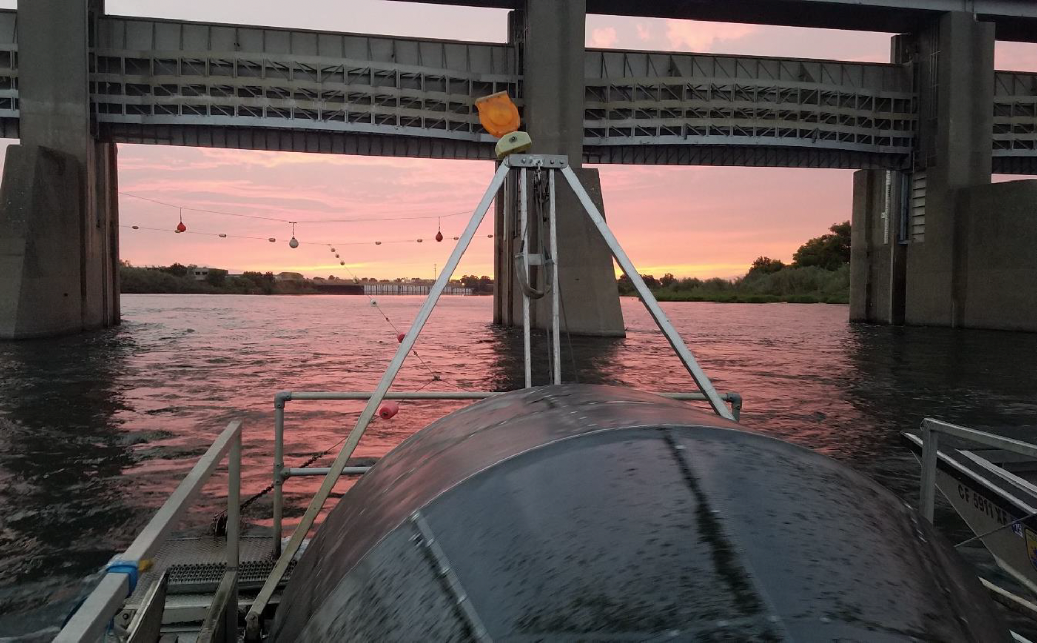
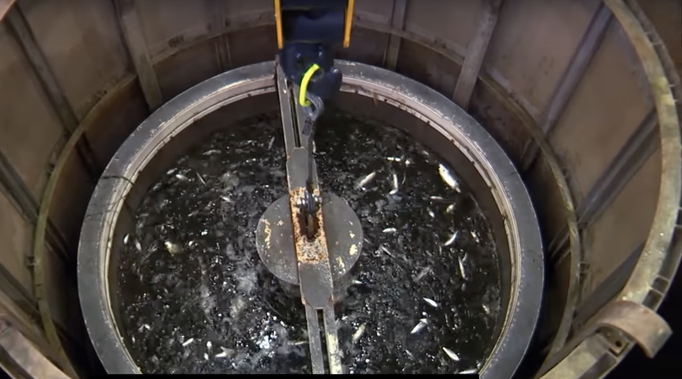
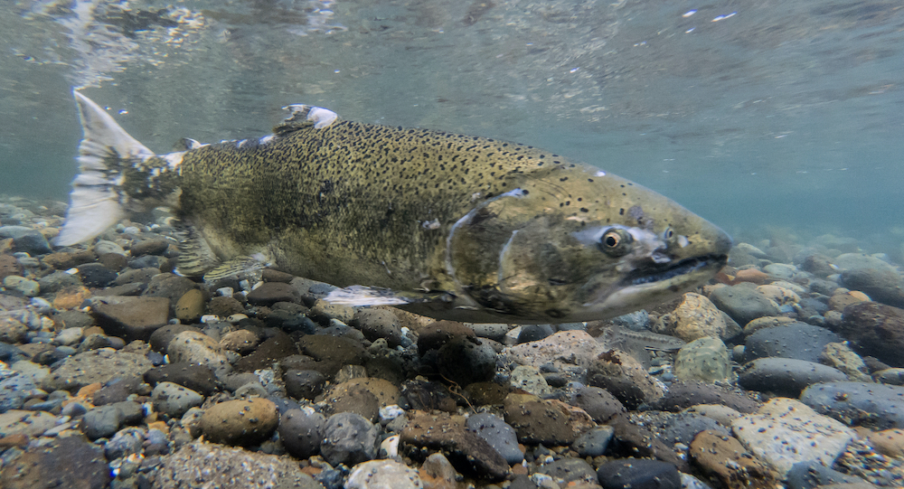
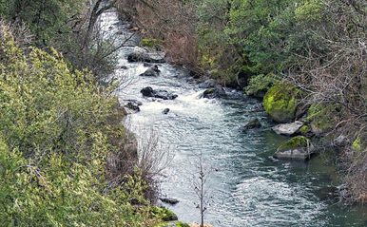
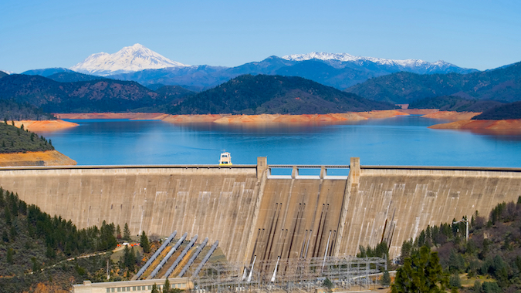
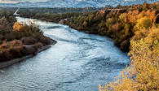
I. SacPAS Data Queries & Alerts
1. Juvenile Monitoring & Sampling
2. Juvenile Salvage & Loss
3. Adult Escapement
4. Temperature Thresholds
5. River Conditions
6. Exposure Index
Notes:
On the website, the Data Queries & Alerts section is organized into 6 topic areas.
For fish we have: Juvenile Monitoring and Sampling, Juvenile Salvage and Loss, and Adult Escapement.
For water we have: Temperature Thresholds, River Conditions, and Exposure Index.
[CLICK]

Slide 21
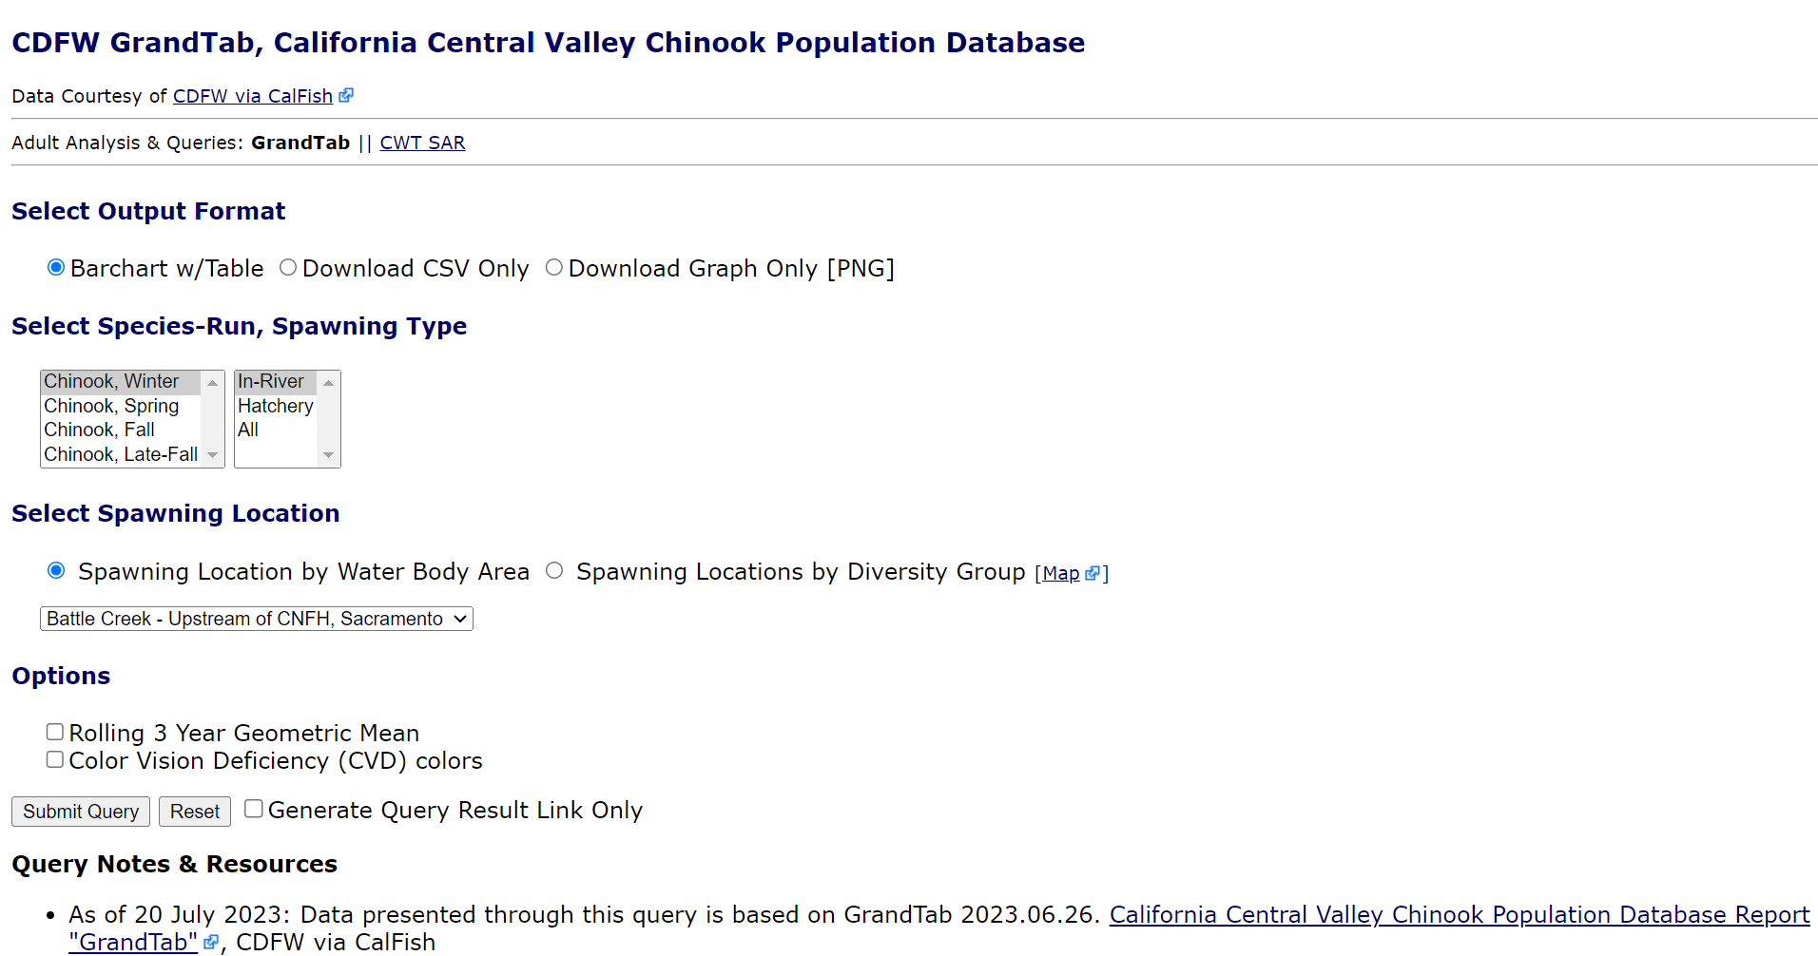
Common Elements of SacPAS Query Interface
Query Title / Type
Data Attribution
Topic Area Queries
Output Formats
Selections:
customized to data and query
Generate re-usable
query URL for automated retrieval
e.g., for “Download CSV Only” option, in Rscript
mydata <- read.csv(queryURL)
Submit button
Query Notes & Resources
Notes:
Before talking about individual tools, I would like to cover common elements that many SacPAS data query interfaces share:
[CLICK]
Query Title / Type
[CLICK]
Primary data source attributions
[CLICK]
Available Topic area queries
[CLICK]
Available output formats for viewing online and downloading
[CLICK]
Selections customized to the data and query
[CLICK]
Submit Query button
[CLICK]
To the right of the submit button, a checkbox to generate a re-usable query URL for automated retrieval based on current selections.
[CLICK]
Query Notes and Resources relevant to the query
Next, I will cover products and tools from 3 of the 6 topic areas.
[CLICK]

Slide 22
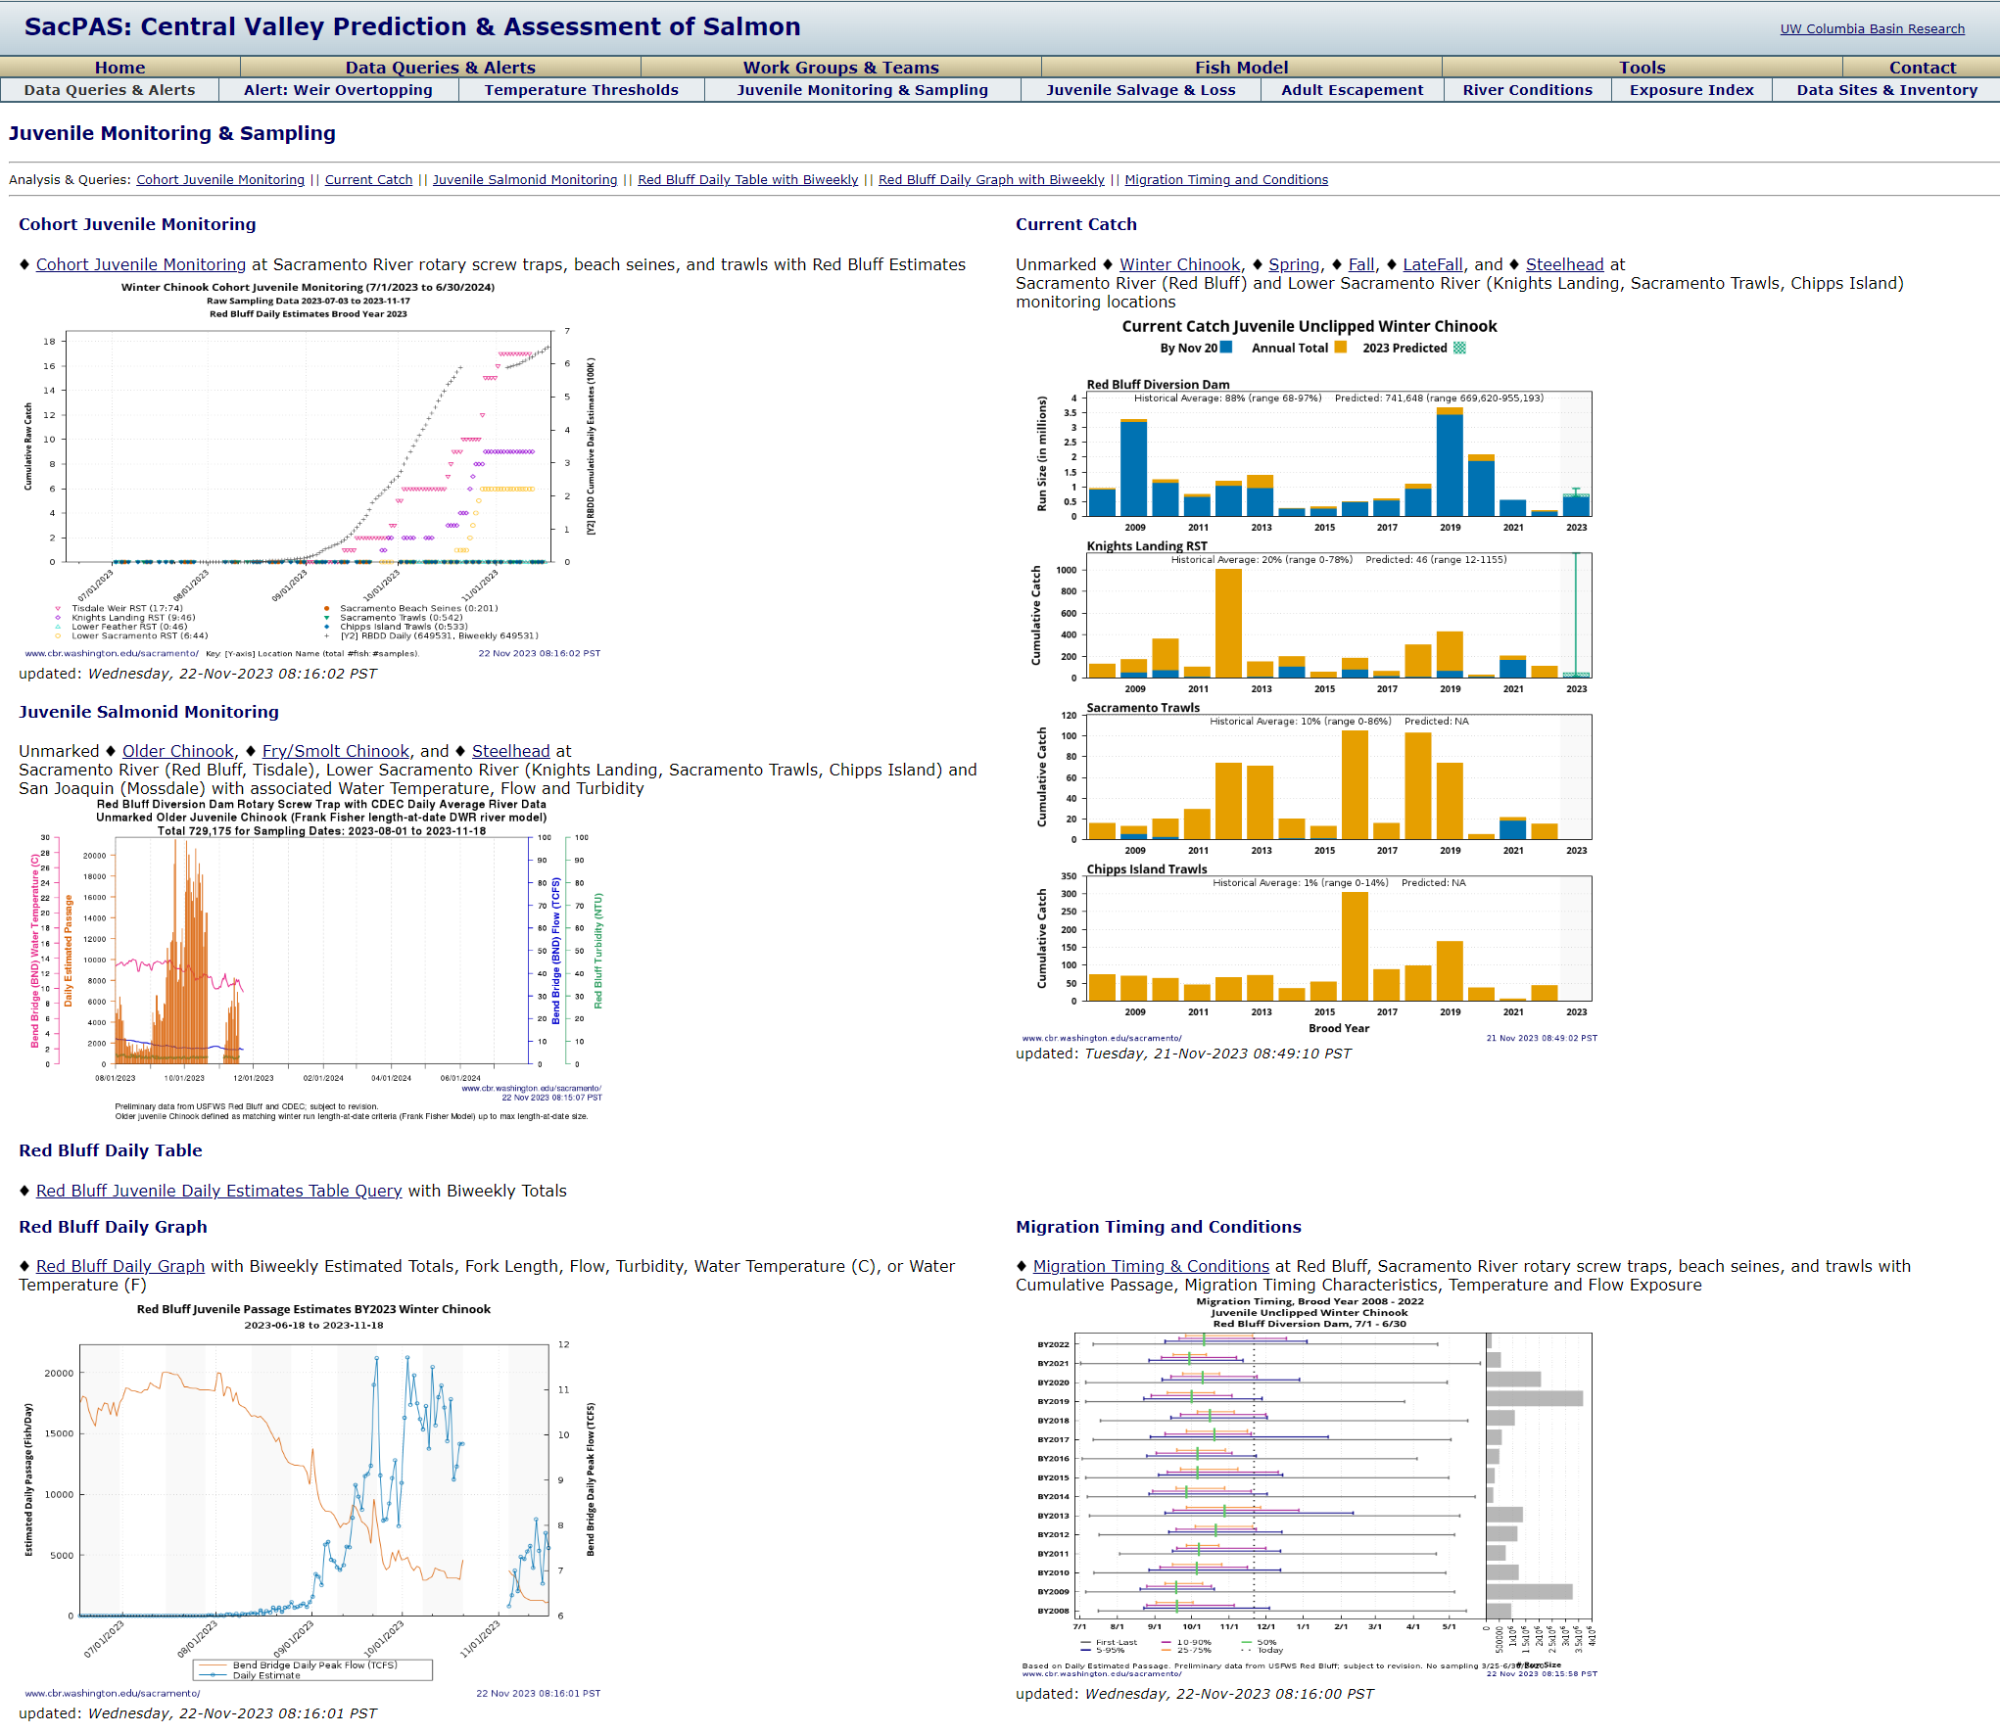
1. Juvenile Monitoring & Sampling
Current Catch
Cohort Juvenile Monitoring
Migration Timing
and Conditions
cbr.washington.edu/sacramento/data/juv_monitoring.html
Notes:
In the Juvenile Monitoring & Sampling category, we provide access to current and historical data collected by multiple agencies at multiple locations. Visualizations and data reports are customized for multiple purposes. In the next 4 slides, I will touch on the connection between 3 of the data products:
[CLICK]
Cohort Juvenile Monitoring
[CLICK]
Migration Timing and Conditions
[CLICK]
Current Catch
[CLICK]

Slide 23
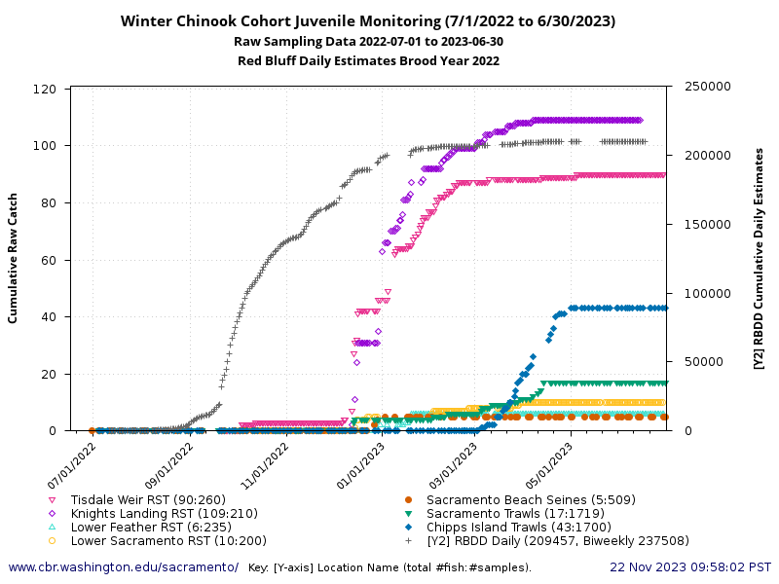
Juvenile Monitoring & Sampling –
Single Brood Year, Multiple Locations
Rotary Screw Traps, Beach Seines, Trawls, and Red Bluff Diversion Dam catch
Single point query access
Brood Year cohorts
  Red Bluff Diversion Dam
  Length-at-Date model run assignments
Tracking migration downstream
“Cohort Juvenile Monitoring” cbr.washington.edu/sacramento/data/query_sampling_graph.html
Notes:
The Cohort Juvenile Monitoring product provides single point access to Rotary Screw Traps, Beach Seines, Trawls, and Red Bluff Diversion Dam data collected by multiple agencies.
The tool is designed to view a single Brood Year cohort at Multiple Locations.
SacPAS creates the Brood Year cohorts based on Red Bluff Diversion Dam and Length-at-Date model run assignment for tracking the migration downstream.
The figure shows fish presence, cumulative catch, and timing at multiple locations.
[CLICK]

Slide 24
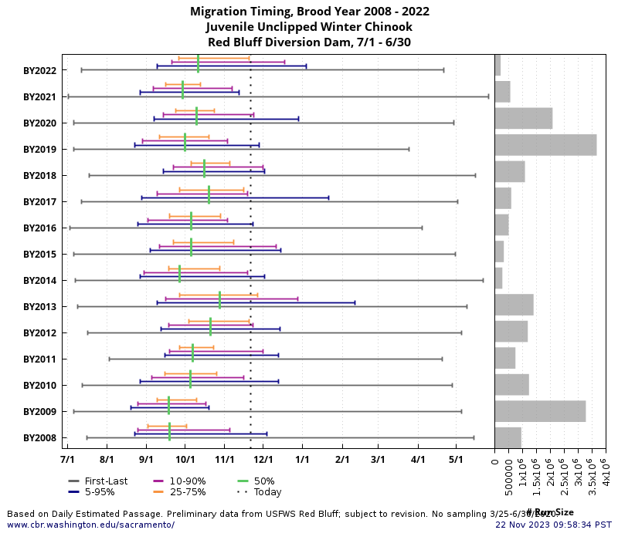
Juvenile Monitoring & Sampling –
Multiple Brood Years, Single Location
Total
Passage Estimates
or Catch
Brood Years
Date Range period
“Migration Timing and Conditions” cbr.washington.edu/sacramento/data/query_hrt.html
Notes:
The Migration Timing and Conditions product uses the same Brood Year cohorts to calculate cumulative percent of catch or passage estimate, over the cohort date period, to compare an estimate of migration timing across historical years.
The visualization is a combination of 2 plots. The main plot on the left shows
[CLICK]
For each brood year, the cumulative percent, represented by the horizontal bars and a vertical bar on the 50% day
[CLICK]
For the cohort date range period.
[CLICK]
The plot on the right shows the total catch or passage estimates for the period.
[CLICK]

Slide 25
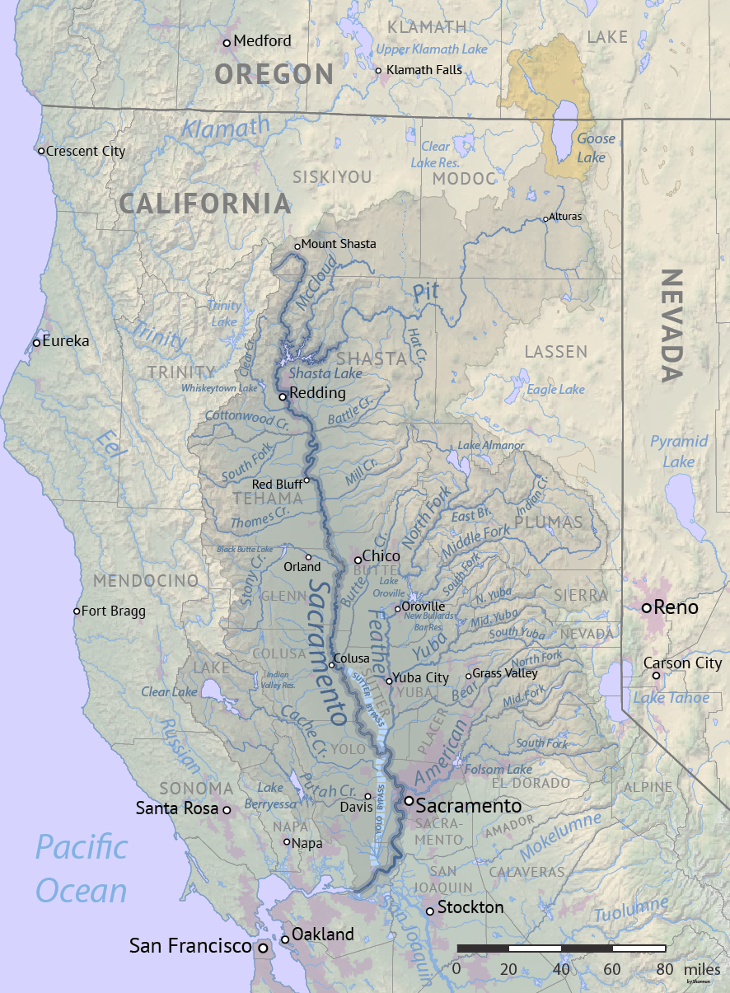
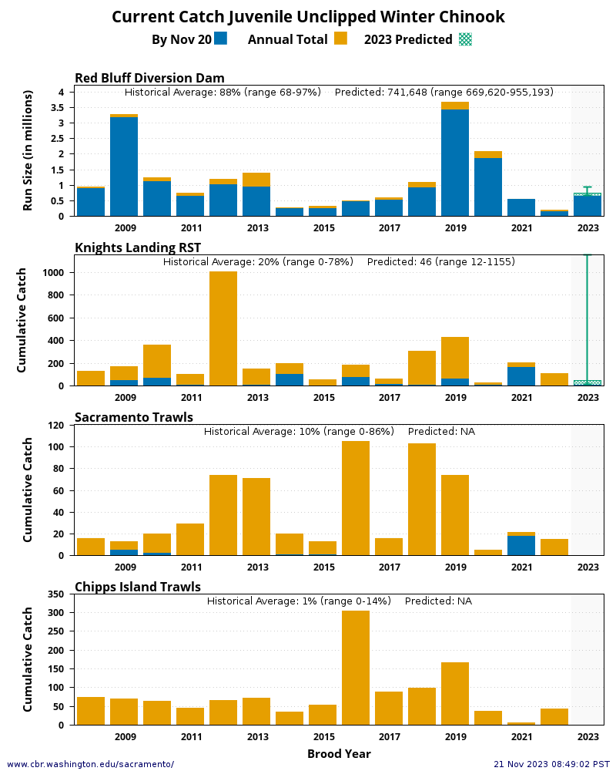
Juvenile Monitoring & Sampling –
Multiple Brood Years, Multiple Locations
Simple “Prediction” based on Historical & Current Years
Red Bluff Diversion Dam
Knights Landing RST
Sacramento Trawls
Chipps Island Trawls
“Current Catch” cbr.washington.edu/sacramento/data/currcatch.html
Notes:
The Current Catch visualization combines historical catch and timing with current year catch at multiple locations.
For tracking the downstream migration of the cohort
[CLICK]
from Red Bluff Diversion Dam
[CLICK]
to Knights Landing
[CLICK]
to Sacramento Trawls
[CLICK]
to Chipps Island Trawls
with a simple “prediction” for the current brood year based on the average estimated historical timing and range.
[CLICK]

Slide 26
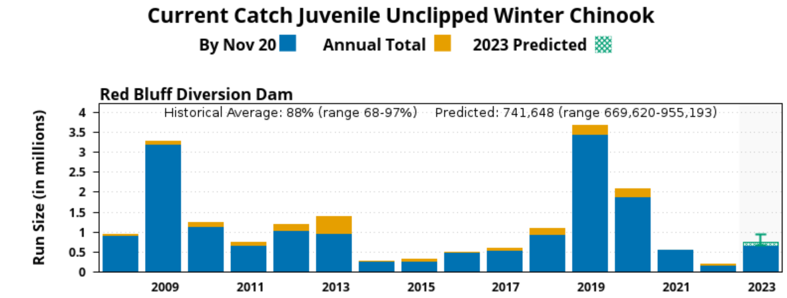
Juvenile Monitoring & Sampling –
Multiple Brood Years, Multiple Locations
Simple “Prediction” based on Historical & Current Years
November 20th, Winter Chinook
Red Bluff BY2023 Prediction
“Current Catch” cbr.washington.edu/sacramento/data/currcatch.html
Notes:
Zooming in on one location from the stacked figure, we can better see the BY2023 prediction on November 20th for Winter Run Chinook at Red Bluff in numbers and chart.
[CLICK]

Slide 27
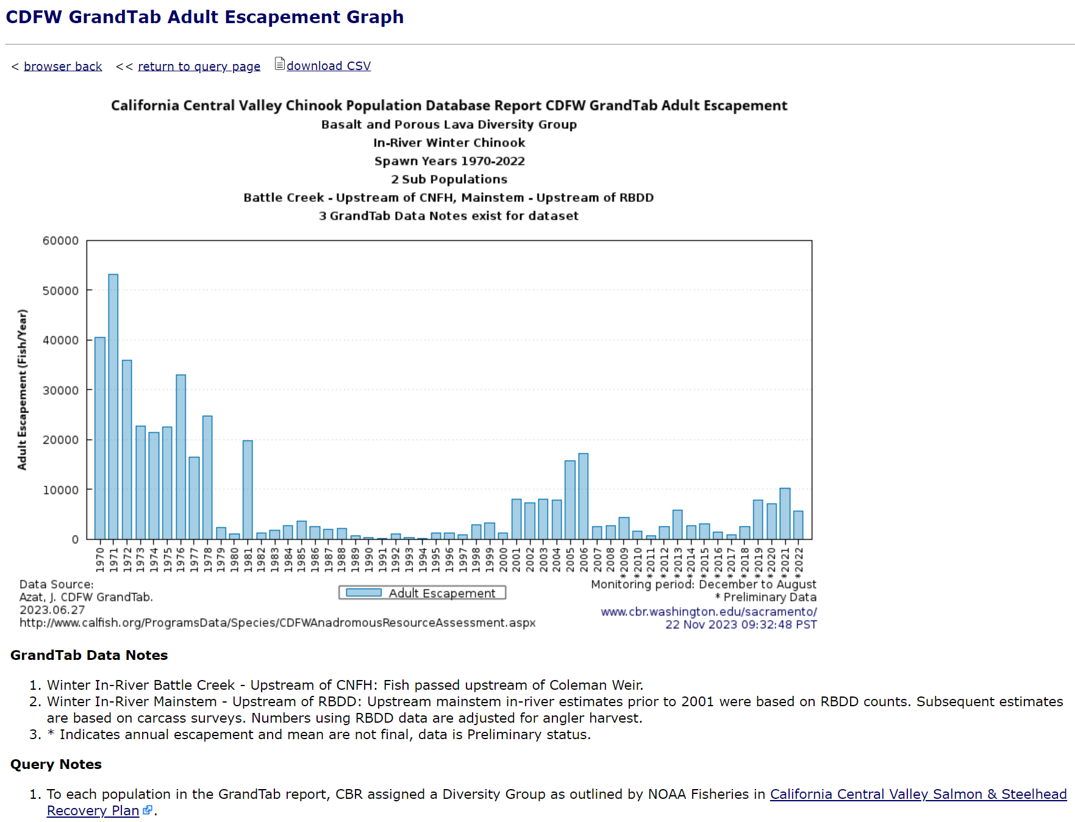
3. Adult Escapement
Detailed title and footnote included in the figure for transparency
“CDFW GrandTab” cbr.washington.edu/sacramento/data/query_adult_grandtab.html
Notes:
In the Adult Escapement topic area, we offer a couple tools including the user-configurable query for the CDFW GrandTab dataset.
I’ll take this time to comment about the online plots. As you may have noticed, the titles can be detailed because the online plots can be considered as stand-alone products,
[CLICK]
so the all information that are usually contained in a caption are specified in various places on the plot,
[CLICK]
including the data source and the timestamp of when the query was run and the product was produced. More detailed information is available on the associated web page. We strive to be as transparent as possible and cite data sources.
[CLICK]

Slide 28
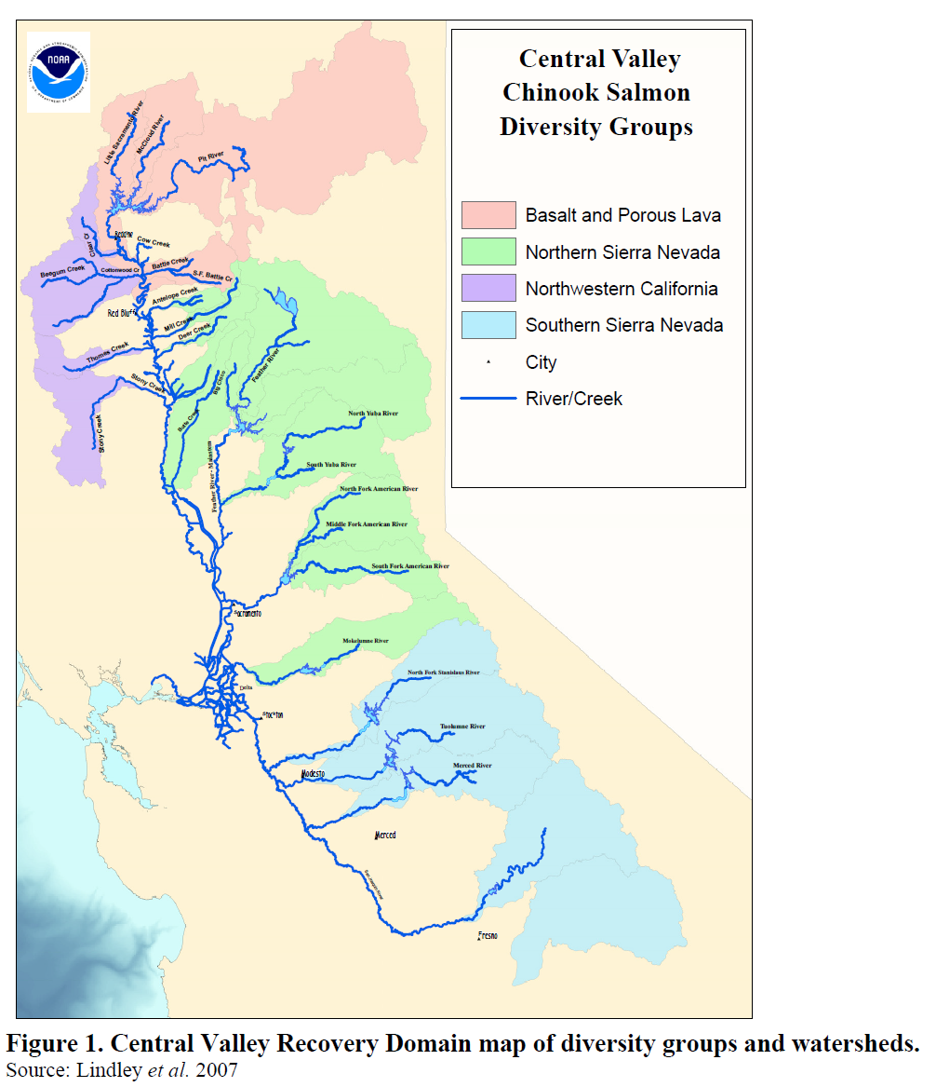
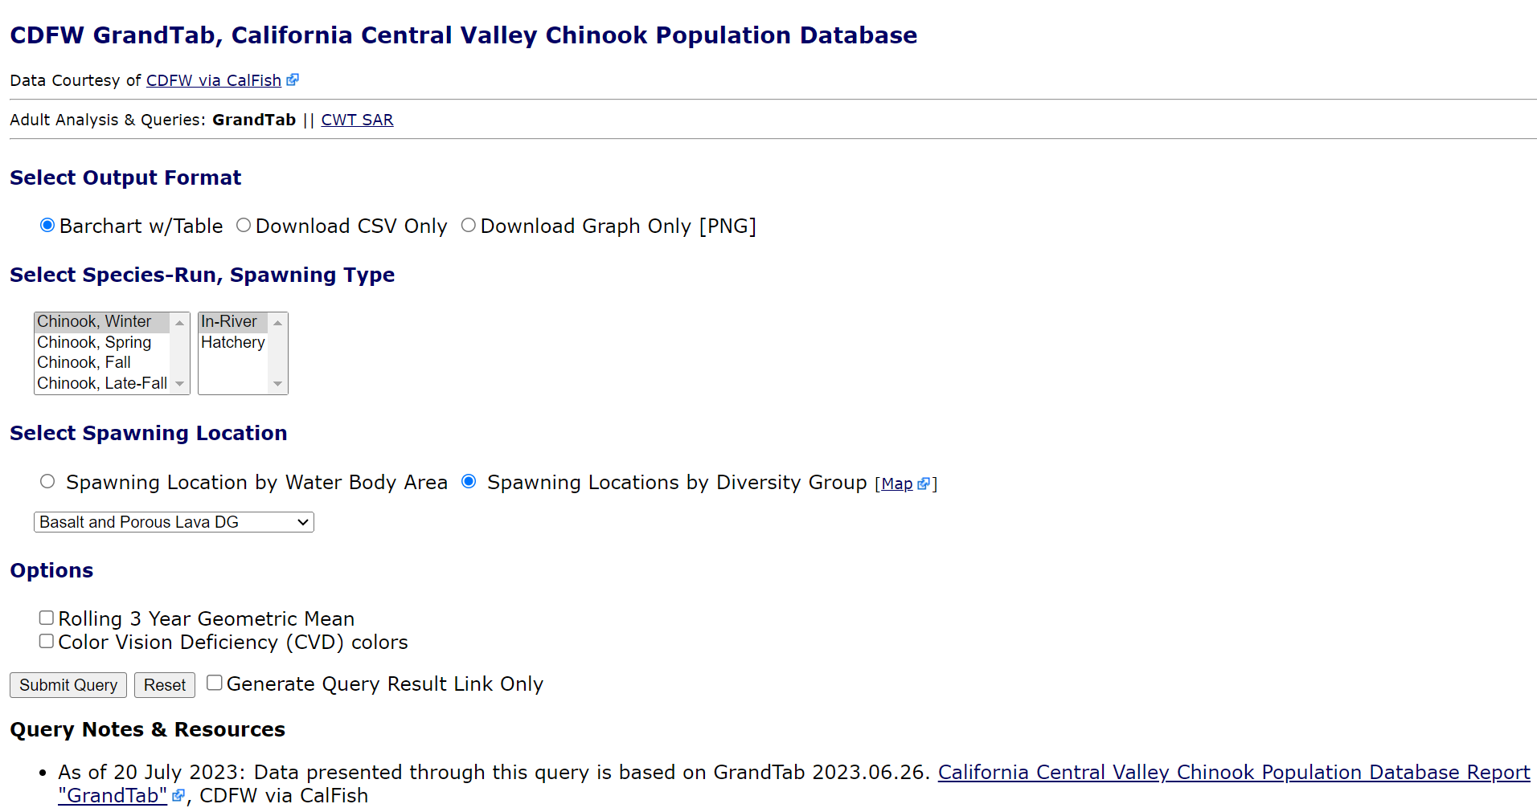
Adult Escapement
“CDFW GrandTab” cbr.washington.edu/sacramento/data/query_adult_grandtab.html
Notes:
In the CDFW GrandTab query interface on SacPAS, there are 2 options for Spawning Location:
[CLICK] 1. select from “Spawning Location by Water Body Area” as reported in the original dataset. Or [CLICK] 2. select from “Spawning Locations by Diversity Group”, a SacPAS value-added option based on assignment of spawning locations to the Diversity Groups shown on the map.
Diversity Group assignments are based on the NOAA 2014 California Central Valley Salmon & Steelhead Recovery Plan
https://www.fisheries.noaa.gov/resource/document/recovery-plan-evolutionarily-significant-units-sacramento-river-winter-run
[CLICK]
Lindley, Steven, T. et al. Framework for Assessing Viability of Threatened and Endangered Chinook Salmon and Steelhead in The Sacramento-San Joaquin Basin. Vol. 5, Issue 1 [February 2007]. Article 4. https://doi.org/10.15447/sfews.2007v5iss1art4

Slide 29
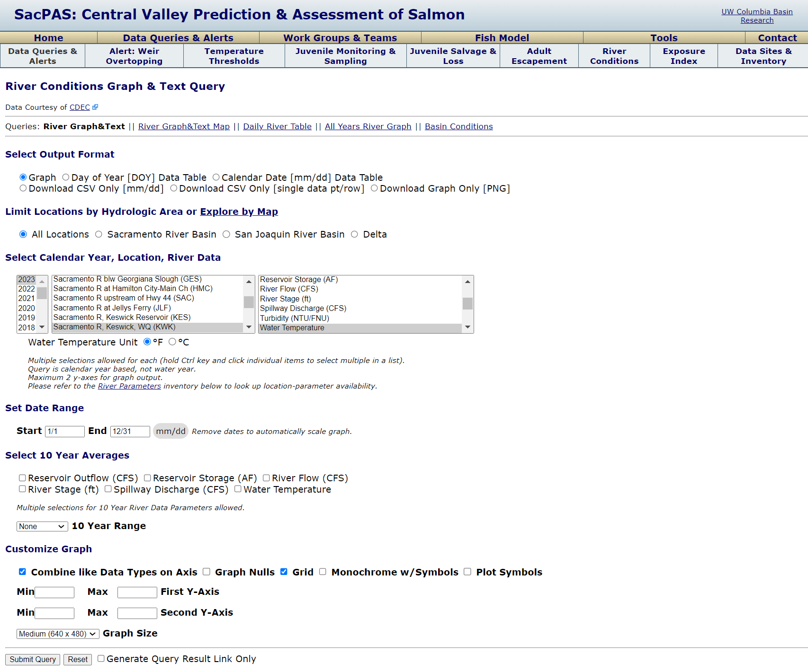
5. River Conditions
“River Conditions Graph & Text” cbr.washington.edu/sacramento/data/query_river_graph.html
Notes:
In the River Conditions topic area, we offer multiple tools including our most flexible and configurable query, the “River Conditions Graph & Text” query.
It contains multiple output formats for viewing visualizations and data tables online and for downloading data.
Multiple selections are allowed in each of the menus for Year, Location, and Data Parameter.
And there are additional selections, settings, and options for further customization, including 10 year averages.
[CLICK]

Slide 30
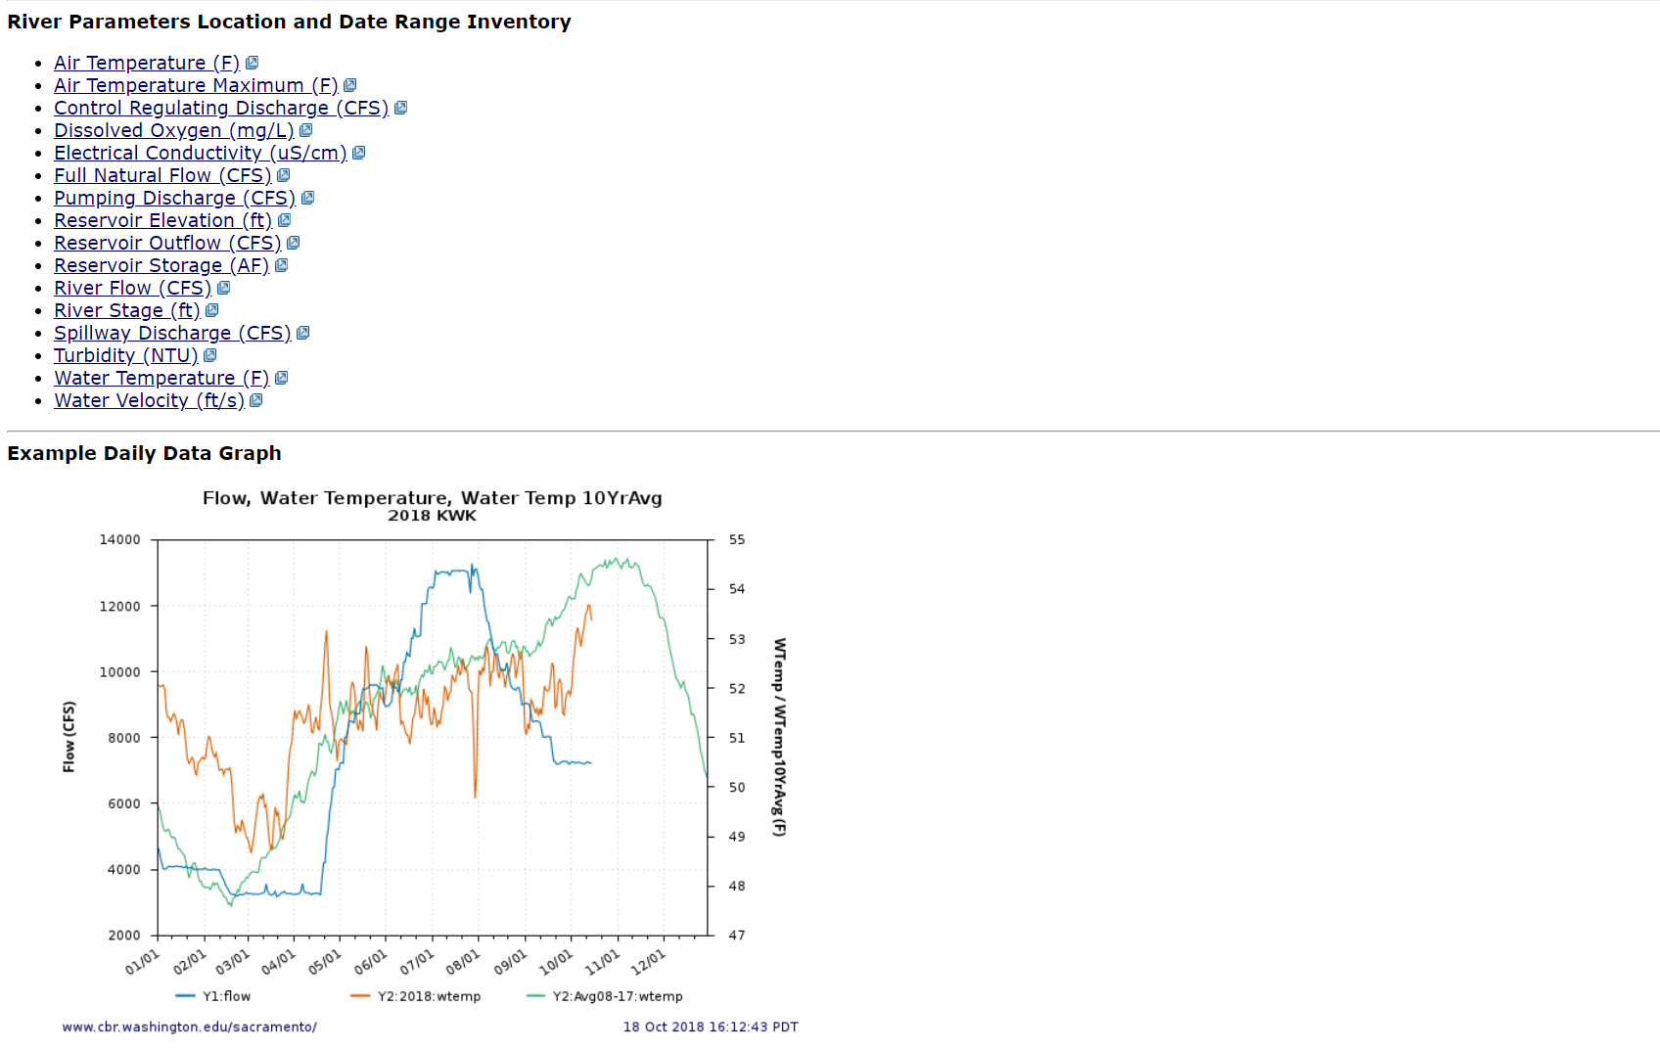
5. River Conditions
“River Conditions Graph & Text” cbr.washington.edu/sacramento/data/query_river_graph.html
Notes:
The query page also includes links to data parameter inventory to assist users with selections.
[CLICK]

Slide 31
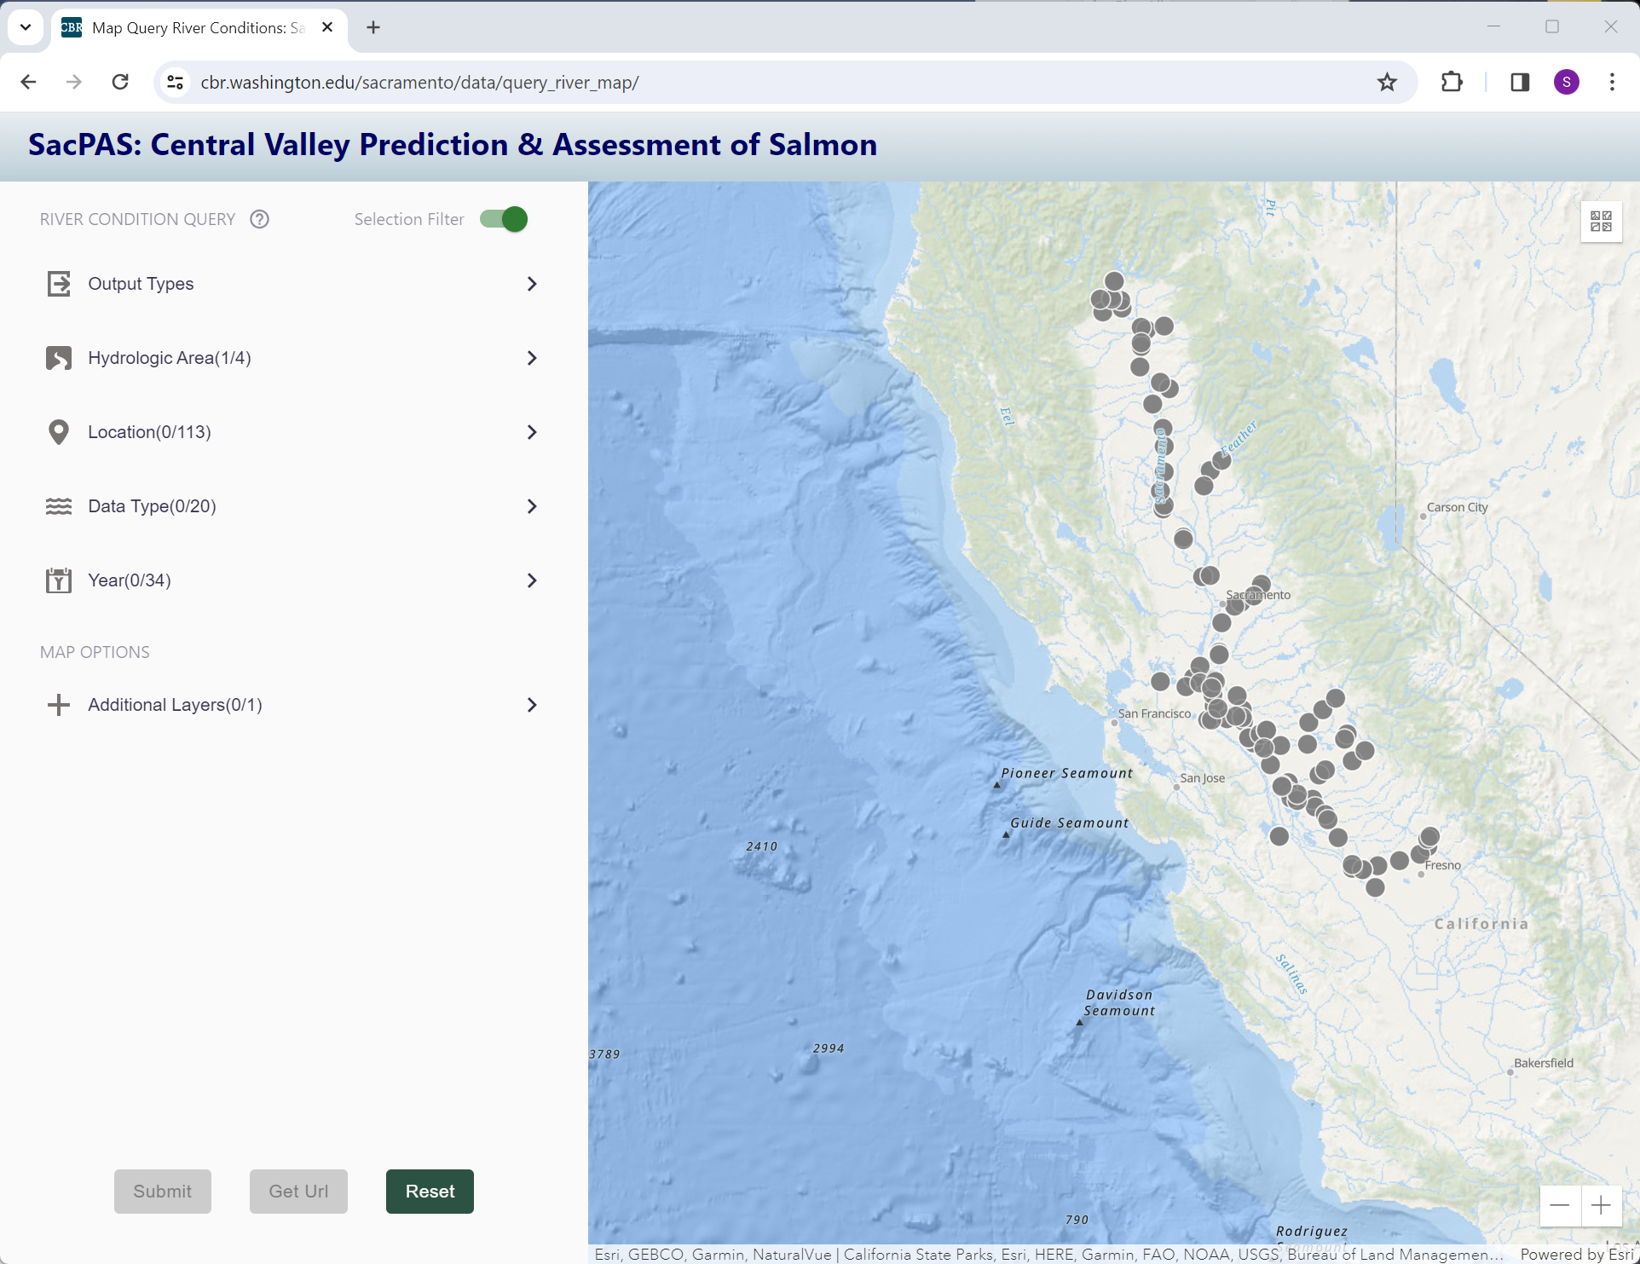
Map Interface for River Conditions Query
Data Type(0/20):
0 selected
20 possible
Exploration Question: what Data Types are available at 4 locations of interest in the San Joaquin River Basin in 2022 and 2023?
cbr.washington.edu/sacramento/data/query_river_map/
Notes:
New to the website in 2023 is the Map Interface for the River Conditions query.
[CLICK]
With the “Selection Filter” option turned on, its default state, the tool provides SacPAS data inventory exploration responsive to user selections for Location, Data Type and Year.
The map interface also allows for querying with the same output types as found in the main query.
[CLICK]
In the next 4 slides, I will cover an interaction with the interface to answer the question:
what data types are available at 4 locations of interest in the San Joaquin River Basin in 2022 and 2023?
[CLICK]
Before we start, I would like to point out that with no selections made, there are 20 possible data types.
[CLICK]

Slide 32
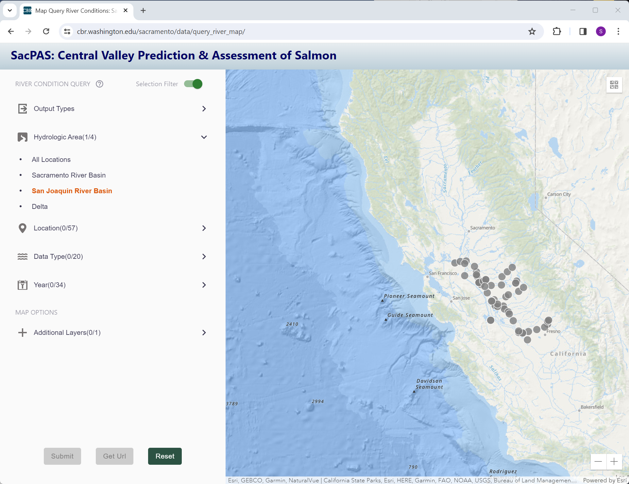
Map Interface for River Conditions Query
cbr.washington.edu/sacramento/data/query_river_map/
Notes:
First, we select “San Joaquin River Basin” from the Hydrologic Area menu. After this selection, we see a reduction of sites available on the map and location menu. The data type and year menus are also responsive to this selection.
[CLICK]

Slide 33
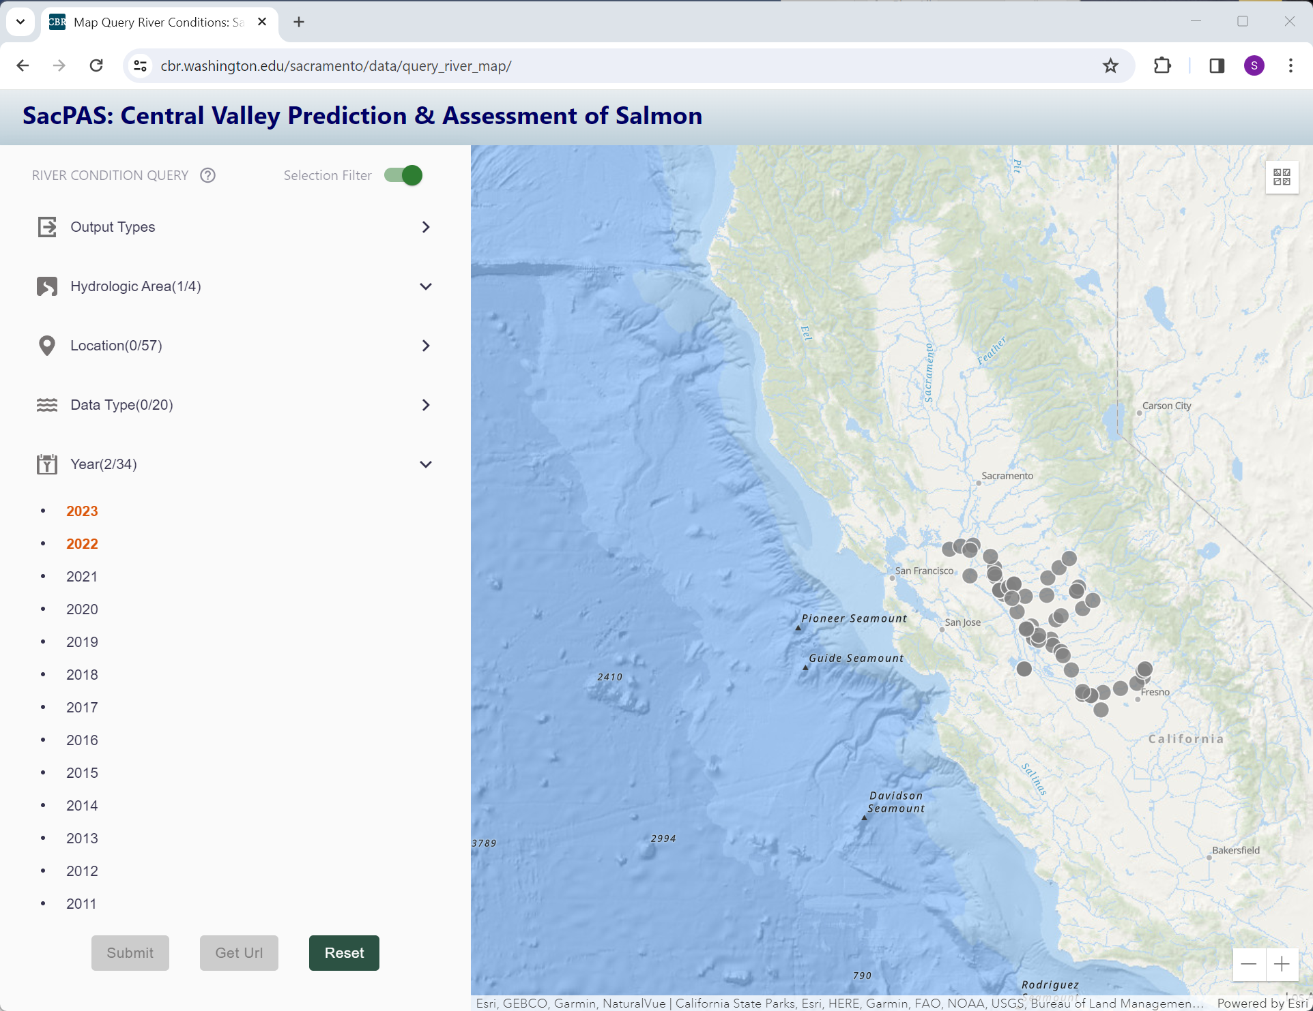
Map Interface for River Conditions Query
cbr.washington.edu/sacramento/data/query_river_map/
Notes:
Next, we select our years from the Year menu.
[CLICK]

Slide 34
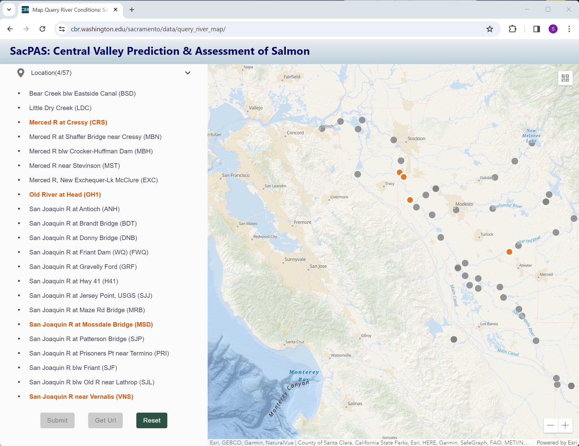
Map Interface for River Conditions Query
cbr.washington.edu/sacramento/data/query_river_map/
Notes:
We are now ready to select our 4 sites of interest, which we can select from the Location menu in the control panel or from sites on the map. The “Submit” button at the bottom of the control panel is still gray, indicating that all elements required for a query have not been selected.
And I will note, the map zoom level is controlled manually by the user.
[CLICK]

Slide 35
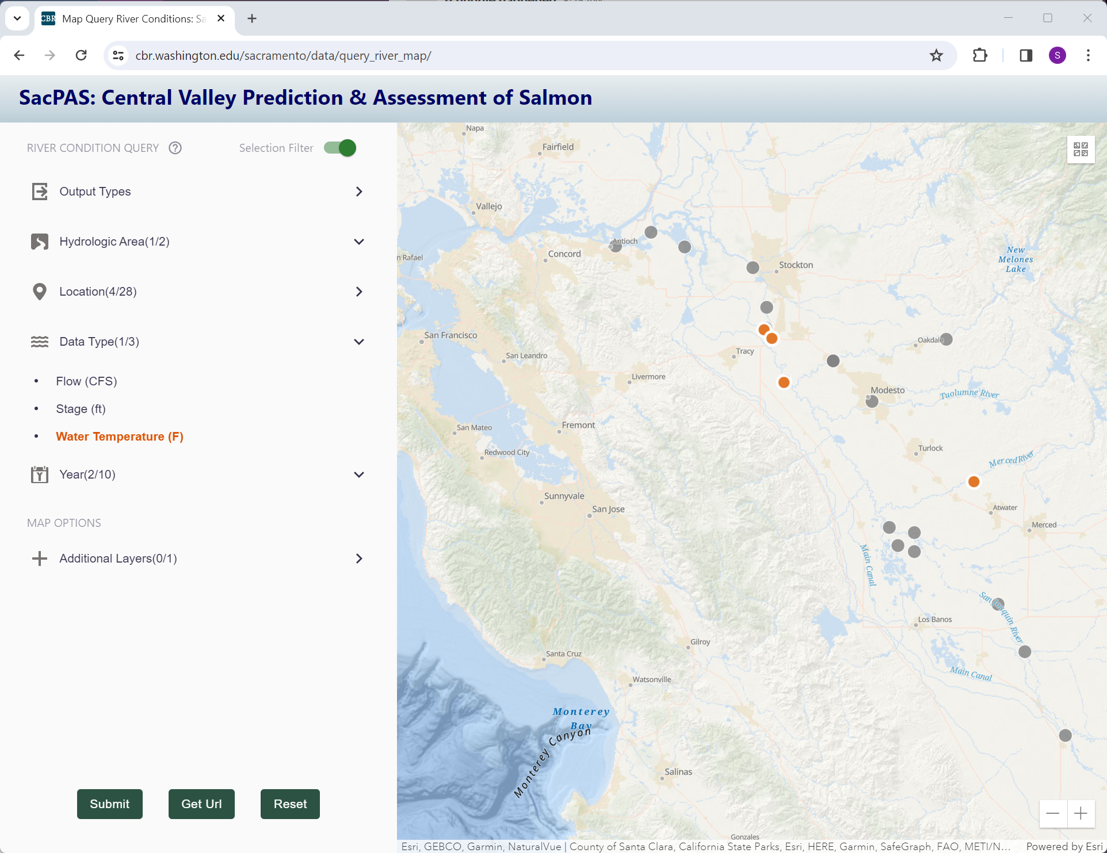
Map Interface for River Conditions Query
Exploration Question: what Data Types are available at 4 locations of interest in the San Joaquin River Basin in 2022 and 2023?
cbr.washington.edu/sacramento/data/query_river_map/
Notes:
Returning to our question: what data types are available? We can now see that there are 3 data types in the Data Type menu based on our selections: Flow, Stage, and Water Temperature.
After selecting one data type in the menu, the “Submit” button is no longer gray. It is now active and clickable. Submitting a query request is now possible. With the “Selection Filter” option turned on, receiving a “no data available” result should not be possible.
[CLICK]

Slide 36
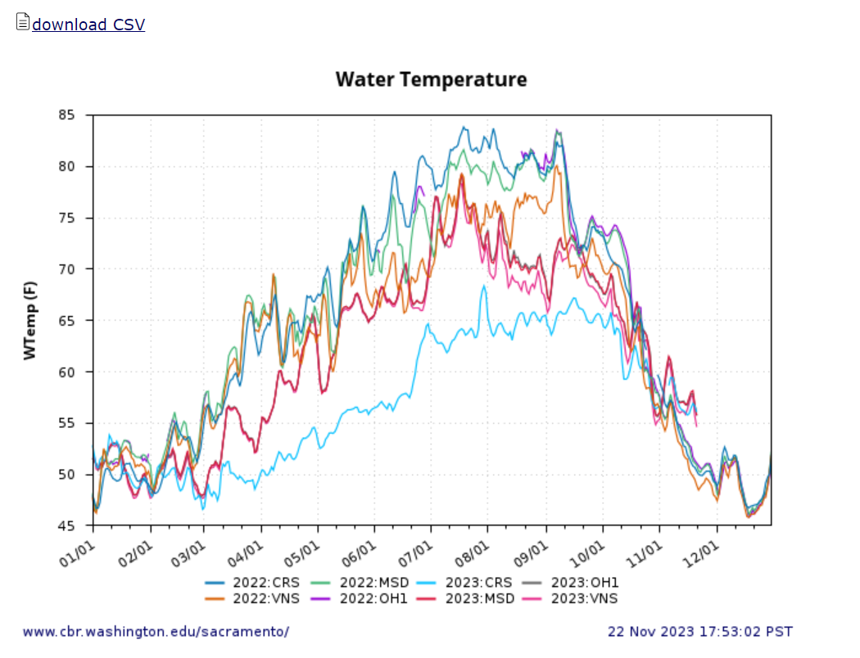
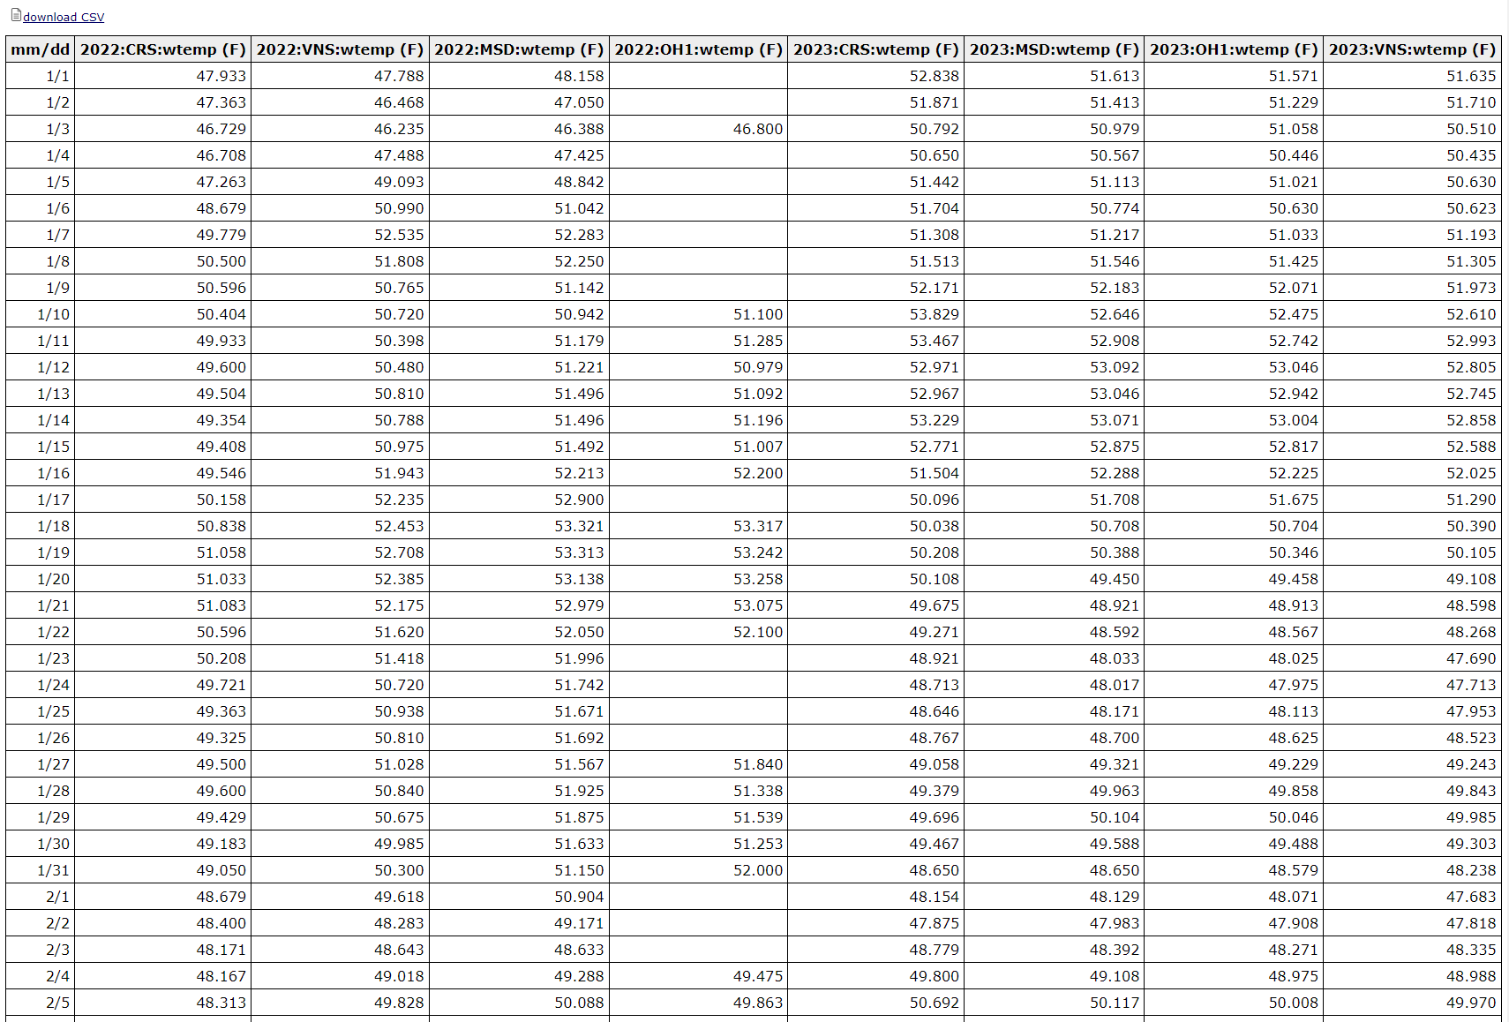
River Conditions Results
“River Conditions Graph & Text” cbr.washington.edu/sacramento/data/query_river_graph.html
“Map Interface River Conditions” cbr.washington.edu/sacramento/data/query_river_map/
Notes:
Whether using the main query page or the Map Interface, submitting a request produces the same output for visualization, data table, or download.
[CLICK]

Slide 37
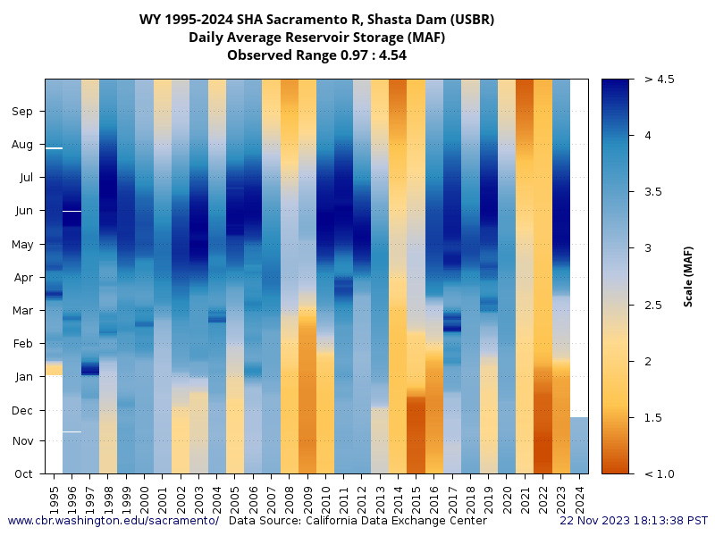
5. River Conditions
Color
Legend
(MAF)
Months through the Water Year
Water Years 1995-present
“All Years River Graph” cbr.washington.edu/sacramento/data/query_river_allyears.html
Notes:
I would like to highlight another tool in the River Conditions area, the “All Years River Graph”. It is designed for visual comparison of conditions for a single location and data parameter. In this example, we are viewing Shasta Dam Reservoir Storage
[CLICK]
for all water years to current day.
[CLICK]
On the left, months from Oct through Sept, and
[CLICK]
on the right, the color legend and scale.
Looking horizontally across water years, we can quickly see certain years have among the highest or lowest reservoir storage during certain periods of the water year.
[CLICK]

Slide 38
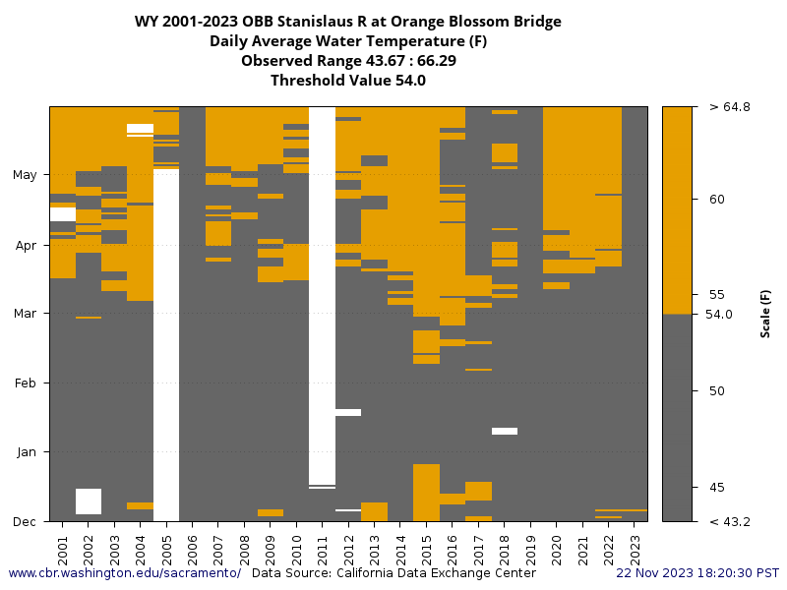
All Years River Graph with Threshold Value
“All Years River Graph” cbr.washington.edu/sacramento/data/query_river_allyears.html
Notes:
The All Years River Graph product includes an option to enter a threshold value, to view the data in potentially more meaningful ways for exploration.
In this example, the threshold is set to 54 degrees Fahrenheit and the period of interest is set to December through May.
If you are wondering about the colors, the combination works for 8 color blindness simulations using “Coblis”, on color-blindness.com.
[CLICK]

Slide 39
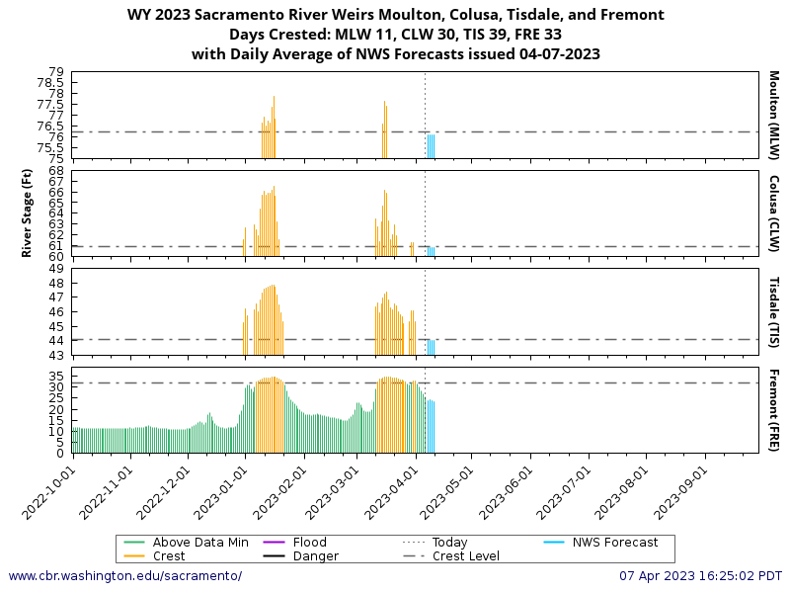
Customized Tools from Requests
Example:
Weir Overtopping Alert tool
  Customized web page
  Email alert service
cbr.washington.edu/sacramento/data/alert_weirs.html
Notes:
Customized tools from requests, enhance the relevancy and usefulness of SacPAS products to the region.
[CLICK]
The Weir Overtopping Alert tool is the original customized tool request. It is comprised of a web page including NWS forecasts of river stage, last 10 days, and water year to date for 4 weirs. In addition, there is a subscription email alert service for a daily email when any weir has crested.
[CLICK]

Slide 40
I. SacPAS Data Queries & Alerts
1. Juvenile Monitoring & Sampling
2. Juvenile Salvage & Loss
3. Adult Escapement
4. Temperature Thresholds
5. River Conditions
6. Exposure Index
Notes:
To conclude Data Queries & Alerts, I would like to acknowledge that there is not enough time in this presentation to cover Juvenile Salvage & Loss, Temperature Thresholds, and Exposure Index categories.
[CLICK]

Slide 41
SacPAS tools
I. Data Queries & Alerts
II. Work Groups & Teams
III. Models: survival, migration, etc.
Notes:
In part 2 of SacPAS tools, I will cover the Work Groups & Teams section of the website.
[CLICK]

Slide 42
II. SacPAS Work Groups & Teams
On SacPAS website:
  Salmon Monitoring Team
  Smelt Monitoring Team
  Stanislaus Watershed Team
In development:
  San Joaquin River Restoration Program
When requests are made:
We aim to provide process/product
Automated
Repeatable
Public
Consistent
Current
All products and services are designed, developed, and refined in collaboration with team members and liaisons.
cbr.washington.edu/sacramento/workgroups/
Notes:
In the Work Groups & Teams section, we provide customized data reports, visualizations, and model output for the Salmon Monitoring Team, Smelt Monitoring Team, and Stanislaus Watershed Team. Products for the San Joaquin River Restoration Program are currently in development.
[CLICK]
When requests are made
We aim to provide process and products that are:
Automated
Repeatable
Public
Consistent
Current
To create content that is relevant to the team, supports the teams’ decision processes, and reduces the burden of repetitive manual creation where possible.
[CLICK]
All products and services are designed, developed, and refined in collaboration with team members and liaisons.
[CLICK]

Slide 43
Help with your tasks that are repeatable
Data visualization tools online
  Integrated data (hourly and daily river, fish sampling, salvage)
  Summary or calculated metrics
  Reference lines or thresholds
  Alerts in real-time
Periods of Coverage
  Pre-season
  In-season
  Historical
  Annual summaries
Portions of handouts
  Data tables and figures
  Updated in real-time before meeting
  All accessible from one place
  (rather than manual compilation)
cbr.washington.edu/sacramento/workgroups/
Notes:
Our goal with these products and services is to help with your tasks that are repeatable.
Providing Data visualizations and data tables online of
Integrated data including hourly and daily river data, fish sampling, and salvage
Summary or calculated metrics
Reference lines or thresholds
Alerts in real-time
Covering needs of different periods for monitoring
Pre-season
In-season
Historical
Annual summaries
We can provide Portions of handouts, for example,
Data tables and figures
Updated in real-time before meetings, depending on data availability
All accessible from one place (rather than having to manually compile from multiple sources)
In the next several slides, I will cover examples from work groups and teams.
[CLICK]

Slide 44
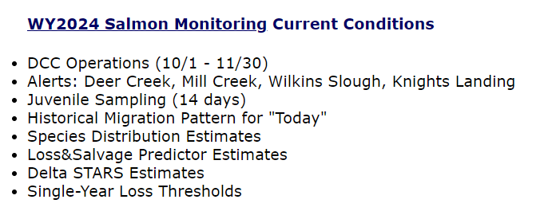
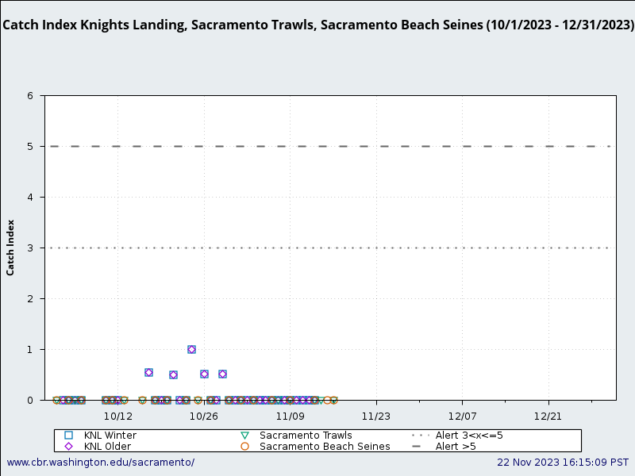
Salmon Monitoring Team: Products Example
Fish data to support trigger decision :
DCC operations by Knights Landing or Sacramento Catch Indices (2019 BiOp PA 4-56)
cbr.washington.edu/sacramento/workgroups/salmon_monitoring.html
Notes:
Customized products for the Salmon Monitoring Team cover early, middle, and late management season reporting from October through June. Including estimates from the Loss & Salvage Predictor and Delta STARS, which Nick Beer will be covering later.
[CLICK]
The Delta Cross Channel operations alert figure visualizes the fish data to support the trigger decision in October and November.
[CLICK]

Slide 45
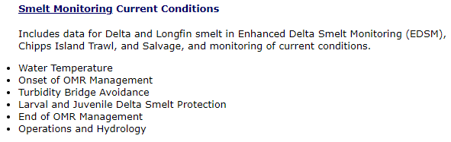
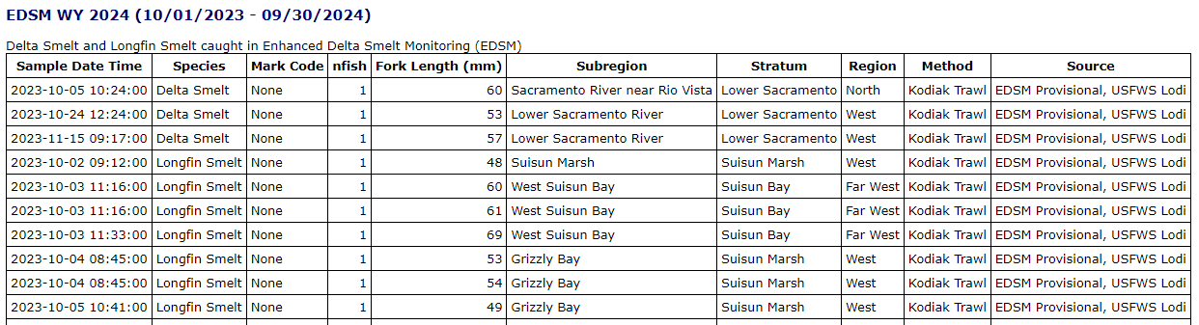
Smelt Monitoring Team: Products Example
Data Source with Data Quality attribute
cbr.washington.edu/sacramento/workgroups/delta_smelt.html
Notes:
Customized products for the Smelt Monitoring Team include reporting Enhanced Delta Smelt Monitoring (EDSM) and Chipps Island Trawls catch updated daily as well as many customized visualizations of hydrologic conditions.
[CLICK]
Shown here is part of the EDSM current water year detail table including data source and data quality. Recent meetings and collaborations with USFWS Lodi Office (the primary source of EDSM) improved the quality of data on SacPAS and the timeliness of reporting.
[CLICK]

Slide 46
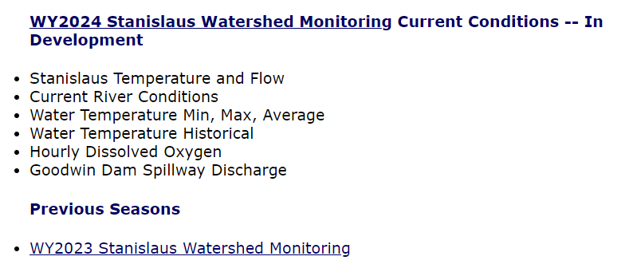
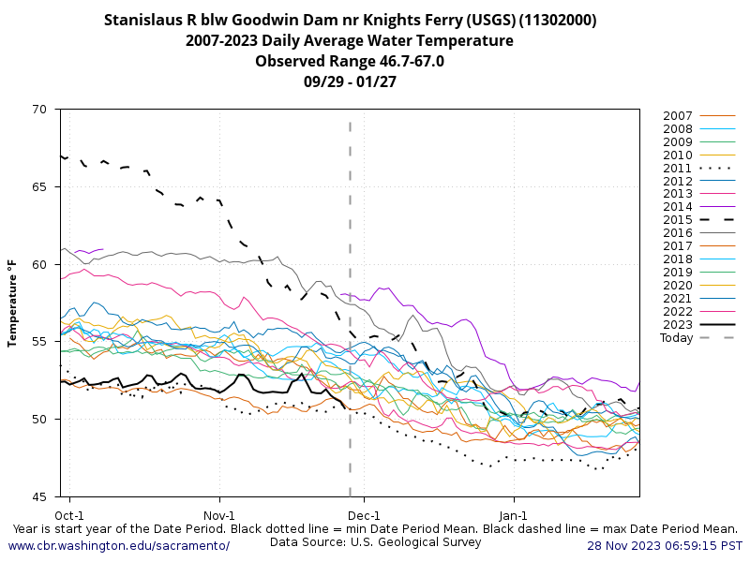
Stanislaus Watershed Team: Products Example
Visual prediction of near-term conditions : moving 60-day window for current and historical Water Temperature on either side of today
cbr.washington.edu/sacramento/workgroups/stanislaus_watershed.html
Notes:
Products for the Stanislaus Watershed Team include reporting on current river conditions for multiple locations and parameters, and multiple customized visualizations of water temperature for both current and historical conditions.
[CLICK]
The moving 60-day window before and after the "current calendar date" figure provides a visual prediction of near-term conditions for water temperature.
[CLICK]

Slide 47
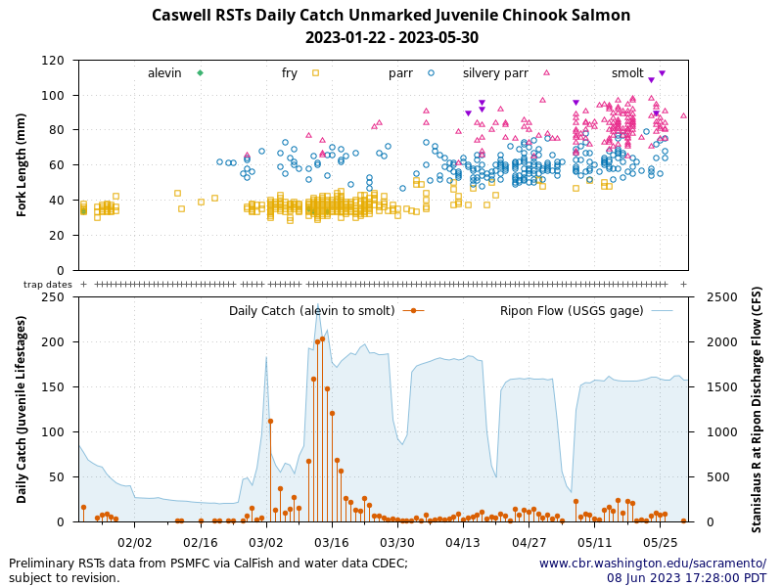
Stanislaus Watershed Team: Process to Product
The Process
The Product
Stanislaus Watershed Team meeting with SacPAS
SacPAS reach out to PSMFC Caswell RST data contact
Possible to provide data publicly?
Any data publishing requirements or concerns?
SacPAS reach out to CalFish
SacPAS Database
Design table structures for data.
Develop retrieval, processing, and loading data procedures.
Verify with primary source.
Implement and update daily.
SacPAS Website
Design visualization based on existing figures.
Develop query and visualization code.
Implement publicly and update daily.
Initial team needs discussion.
Additional needs and content discussions.
Request to coordinate with Caswell RST data contact to establish data upload process.
Notes:
Lastly, I will cover one real world example of process to product.
[CLICK]
The Product
Is this figure which shows daily Caswell RST total juvenile catch and Ripon flow on the bottom and the distribution of catch by size and lifestage on the top with trapping dates indicated by the “+” symbol in between.
[CLICK]
The Process started with a Stanislaus Watershed Team meeting with SacPAS to discuss initial team needs and was followed by additional needs and content discussions.
As one result of discussions, the SacPAS Team reached out to the Pacific States Marine Fisheries Commission (PSMFC) Caswell RST data contact. We inquired whether it would be possible to provide data publicly and if there were any publishing requirements or concerns.
The SacPAS Team reached out to CalFish, where other RST datasets from the region are made publicly available, with a request to coordinate with Caswell RST data contact to establish a data upload process.
Once the dataset was made publicly available, the SacPAS database manager designed table structures for the data; developed procedures for retrieval, processing, and loading into local database; verified with the primary source; and implemented daily updates.
Finally, the SacPAS web computing specialist designed the visualization based on existing figures produced by PSMFC; developed query and visualization code;
[CLICK]
and implemented daily updates on the website producing this figure.
This concludes Work Groups & Teams.
Back to you, Jenn.
[CLICK]

Slide 48
Presentation Goals
AWARENESS
of SacPAS tools available
APPROACH
of how we provide SERVICE
Kickstart at workshop
for
FEEDBACK
and
COLLABORATION
Notes:
Thank you Susannah.
Hopefully, you all have gained increased awareness of some of the SacPAS tools available and in how we approach our work.
[click]
And this helps kickstart some ideas for you in terms of feedback and collaboration later today or into the future.
And now I will pass it on to Nick to cover modeling tools.

Slide 49
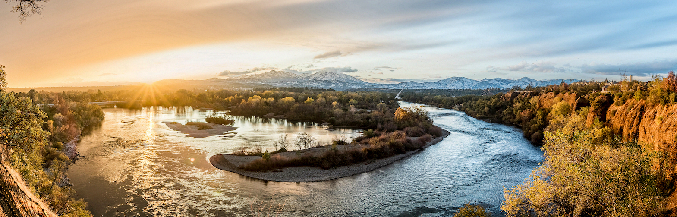
SacPAS tools
I. Data Queries & Alerts
II. Work Groups & Teams
III. Models: survival, migration, etc.
Notes:
Thank you. I will talk about some of the interactive modeling pages we have on the SacPAS website.

Slide 50
Models: Survival, Migration, etc.
Fish Model
  Egg-to-Fry model
  (Anderson et al. 2022, Martin et al. 2016)
Loss & Salvage Model
(Tillotson et al. 2022)
STARS Model
(Survival Travel And Routing Simulation;
Perry et al. 2018, Hance et al. 2021)
Notes:
What all of our model pages have in common is that mathematical formulations of ecological processes are brought to life. The word ‘model’, in this context, refers to a process that is simulated, and typically there is no closed-form for generating results. These models rely on mathematical formulations (such as those cited here to Anderson, Martin, Tillotson, Perry and Hance) which are the machinery that turn inputs into outputs, and more precisely: data into results. click

Slide 51
Models: Survival, Migration, etc.
Fish Model
  Egg-to-Fry model
  (Anderson et al. 2022, Martin et al. 2016)
Loss & Salvage Model
(Tillotson et al. 2022)
STARS Model
(Survival Travel And Routing Simulation;
Perry et al. 2018, Hance et al. 2021)
Exploratory tools
(Shiny apps)
  Growth model
  Survival Model
  Migration Model
  Temperature Profiler
  etc.
Notes:
Related to model webpages are various ‘Exploratory Tool’ pages. These are interactive tools that reveal mathematical formulations. In a word: you can see how an equation works. ALL of the bulleted items, in both columns, are SacPAS web pages.

Slide 52
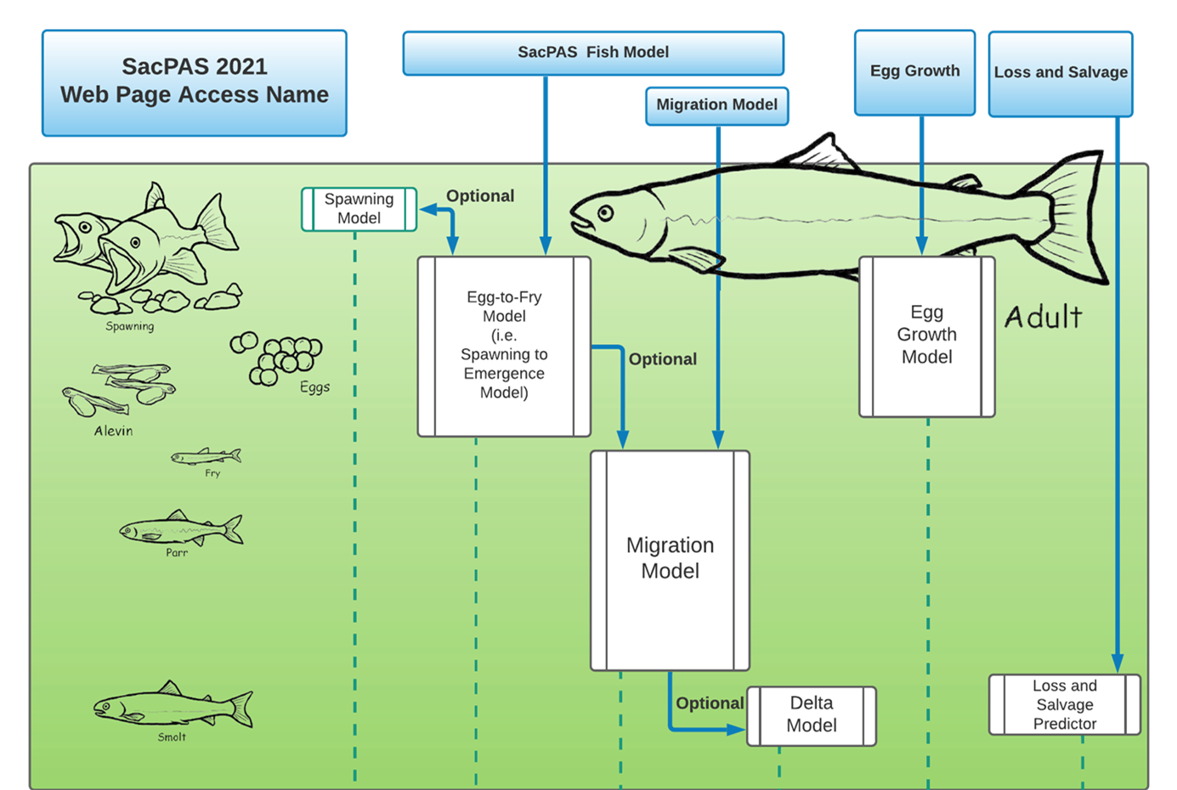
STARS
Keswick Dam
Red Bluff Diversion Dam
MAP
Knights Landing
American R
STARS
Model
DCC
Chipps Island
Notes:
Chinook salmon in the Sacramento River are the focus of several models.
In the green box is an illustration of how five distinct models (at the top in the blue boxes) differ in scope pertinent to Sacramento River Chinook. The Fish Model functions as an umbrella to encompass both the Egg-to-Fry Model and the Migration Model, which can be run independently or linked together.

Slide 53
STARS
Keswick Dam
Red Bluff Diversion Dam
MAP
Knights Landing
American R
STARS
Model
DCC
Chipps Island
Notes:
I am going to briefly introduce three of these pages: the Egg-to-Fry Model, the Loss and Salvage model and the STARS model.

Slide 54
Short-term Forecasting and Scenarios
Model | Forecasting Timeframe | Scenario Generation | Data Input
Egg-to-Fry (survival & emergence timing) | ~ months | Unlimited | River temperature timeseries Redds or carcasses timeseries Flow timeseries Mathematical parameters
Loss & Salvage | 7 days | 7 days | Exports; SJR flow; DCC gate status; SR flow; OMR flow; precipitation at Stockton; Water temperature, Mallard Island
STARS (Delta Survival Travel And Routing Simulation) | 5 days | NA | SR temperature, Freeport; Fremont Weir stage & overtopping; Discharge, SR at Freeport & Rio Vista, Yolo Bypass at Woodland; incl. forecasts from CA NV River Forecast Center
 | NA | Fish distribution | Hypothetical Arrivals at Knights Landing
Notes:
These three models have varying ability to use environmental forecasts and user-provided scenarios.
The Egg-to-Fry model’s forecasting timeframe varies depending on the time of year. NOAA’s CVTemp forecasts extend only to the end of November, but during summer, will project all the way through the Winter Chinook egg development period.
The Loss and Salvage model works on a weekly time step which you can adjust to create a scenario, but only for the very latest environmental conditions.
And the STARS model uses environmental forecasts up to 5 days in the future, including the data from CA NV River Forecast Center.
Think of a model as a kitchen recipe and the scenario is your modified ingredient list.

Slide 55

Fish Model on SacPAS:
Egg-to-Fry Model Online Tool
Model focusing on
thermal stress during
egg incubation for
Sacramento River
Chinook salmon
Predict survival &
emergence timing
Allows resource managers
and the public equal access to
evaluate water operation plans
https://www.cbr.washington.edu/sacramento/fishmodel/
Notes:
The Egg-to-Fry model is the most complex, yet versatile of the models we have. It can show retrospective results, make forecasts and handle scenarios with user-provided inputs. This opening page has schematic and overview information that are replaced by results after the model is run. In the next slides we will look more closely at parts of the page.
I must thank the many researchers, data collectors and contributors who have offered ecological insight, comments, suggestions, and corrections. This would not have been possible without you. Again, your contributions are invaluable.

Slide 56

Fish Model on SacPAS:
Egg-to-Fry Model Online Tool
Temperature,
redds, carcasses
data inputs
Graphs
Results output, incl. downloads
Survival model specifications
Run
Model
More info,
incl. methods
Notes:
Interface of the online tool
[click]
Data inputs & survival model specifications
[click]
The Egg to Fry model is run by pressing “RUN EGG Model” which then launches the simulation, presents graphics and offers results.
[click]
No further manipulation is necessary.
However, the page is a mixture of data-input controls; mathematical model formulations; graphical controls; output downloads; visualizations; and links to further information.
[click]
We will look closer at some of them and how they affect results.

Slide 57


Fish Model on SacPAS:
Egg-to-Fry Model Online Tool
Temperature data input:
Salmon redds data input:
Forecasted (NOAA; USBR)
Redd, Carcass Survey data (CDFW)
Historical (CDEC)
Custom
(text; upload)
Custom
(text; upload; Shiny tool)
Forecast
https://www.cbr.washington.edu/sacramento/fishmodel/
Notes:
When you use the Egg-to-Fry Model you have control over several of the inputs and controls. Here, specifically are the input areas for:
[click] temperature and
[click] redd distribution.
Each of which has three possible flavors: historical, forecast, or scenario.

Slide 58

Fish Model on SacPAS:
Egg-to-Fry Model Online Tool
Survival model specifications:
Check-mark option:
Critical stage:
Temperature-dependent mortality only is ON
No density-dependent effects
No background mortality rate for fry
Stage-dependent:
Egg Hatching Stage
Input values:
Stage-independent:
All of egg incubation
Default values from studies
Enter custom values
https://www.cbr.washington.edu/sacramento/fishmodel/
Notes:
In this part of the page you have access to the details of how mortality will be computed. This is one of the places where you can control the mathematical formulation based on your assumptions. You can choose among formulations and control the parameters if desired. The defaults are parameters from published sources. There is an analogous section on the page for specifying the development rate model.

Slide 59


Fish Model on SacPAS:
Egg-to-Fry Model Online Tool
Graphic
output
controls
Redd dewatering specifications
(optional)
https://www.cbr.washington.edu/sacramento/fishmodel/
https://www.noaa.gov/sites/default/files/legacy/document/2020/Oct/07354626849.pdf
Notes:
Elsewhere on the model page are additional controls such as these for page display (with the yellow tint) and dewatering mortality in the grey area which has controls like other inputs on the page. You can not control the dewatering mortality rates, these are look-up tables based on the 2006 USFW study on dewatering and stranding.

Slide 60

Fish Model on SacPAS:
Egg-to-Fry Model Online Tool
Notes:
After the ‘RUN’ button is pushed, the simulation begins. When the page refreshes, results including these plots are created. The heatmap on the left shows the thermal of regime of the river and the modeled presence of Chinook redds and their status at hatching. If any redds were exposed above the critical temperature, they would be colored red. 2023 has been a wet year with abundant cold water and these redds, shown at hatching, were not exposed above the critical temperature.
On the right are timeseries of data and model results. This combines redd-status, temperature, and flow. Redd status during incubation is shown with the colored histograms. (click)

Slide 61
Fish Model on SacPAS:
Egg-to-Fry Model Online Tool
KWK gage
data
Notes:
The dark blue line is KWK gage temperature, which is below the selected critical value of 53.3F, shown as a dotted horizontal line. TDM, or temperature dependent mortality, was computed to be 0 this year. As you likely know this is not always the case.

Slide 62

Fish Model on SacPAS:
Egg-to-Fry Model Online Tool
KWK gage
data
Notes:
By contrast, results for 2021 tell a different story. TDM was computed to be 74%-76%. I give you a range because the Anderson and Martin formulations generate alternative results with alternative assumptions. By the time of hatching, shown here, every cohort of redds (but one!) had been exposed above the critical temperature. In the timseries plot on the right, note how the KWK gage profile is well above the critical temperature threshold for most of the incubation period. The model parameters and assumptions are the same as for the previous 2023 results, so the thermal data is driving the differences. For any run, ALL of the data you see are accessible for downloading. These data are also, of course, accessible from the SacPAS query tools pages that Susannah has introduced.

Slide 63


Fish Model on SacPAS:
Egg-to-Fry Model Online Tool
Check the box
Send Results to Migration Model
Notes:
I have one last comment about this model page: The results can be generated without the User Interface. To get you started thinking about how to use this, note that you can generate query strings, just as with your data queries. Click the little box before pressing “RUN EGG model”, and they are generated instead of the simulation. There are some scripting options that can automate your processes, and certain types of input files can be bulk-loaded if necessary. Please ask us for assistance if you are interested.
Can also send results to Migration Model.
Now let’s move on to Loss and Salvage.

Slide 64

Loss & Salvage Predictor
Weekly forecasts of
Steelhead & Chinook
loss at the pumps
Using historical
observations of loss & environmental conditions
Tillotson et al. (2022)
  Quantile regression forest approach
Loss & Salvage Predictor Online Tool: https://www.cbr.washington.edu/sacramento/lossandsalvage/
Historical & real-time data: https://www.cbr.washington.edu/sacramento/data/delta_loss_summary.html/
Notes:
The Loss and Salvage predictor is based on the work by Tillotson et al. 2022. This is not a replacement for the Salvage and Loss summary page which has many details, but it does provide a visualization and ability to see the data in context of the entire year.

Slide 65


Loss & Salvage Predictor
Get latest forecast
and access scenario forecasting
Hindcast
Notes:
These are the controls that launch the model. Unlike the Fish Model, there is no access to formulations, except a choice between calibrations. However, a scenario forecast method is built-in for you to project environmental data for the next week. Press the RUN button and get the forecast or hindcast. When the page returns it looks like this: (click)

Slide 66

This week’s averages. They are projected to the next week except “sac” flow which user has raised and the text is now colored green.
Counts are very low compared to historical numbers, so model was forecasting a “catch-up” and thus a wide confidence band
The forecast now includes an adjusted Sacramento flow
Notes:
This run was made March 24, 2023 near the middle of the steelhead and winter-run juvenile migration.
Results are in tables and plots. The environmental inputs are displayed with sliders which are set to the most recent weekly averages, and you can accept these for the subsequent week or make your own forecast to see how sensitive are the results to the inputs. This is the available scenario method with this model. What you cannot alter are the fish data, and… spoiler alert: the current week’s loss is the principle predictor for the following week, because it is an index of the overall run distribution.
(click)
In this example, the Sacramento River flow was maximized to create a scenario. Its value changes to dark green.
Finally, I would like to present the STARS model.

Slide 67


STARS
Example with Winter-Run Chinook Salmon
Select Display:
Cohort survival,
Survival (season),
Travel Time (season),
Route-spec. Survival,
Route-spec. Travel Time
(Delta Survival Travel And Routing Simulation;
Perry et al. 2018, Hance et al. 2021)
Late Fall-run
& Winter-run Chinook
Delta Environment,
Sacramento River:
Fremont Weir stage (ft)
& overtopping (0/1)
Freeport Temp. (°C)
Freeport Discharge (cfs)
Rio Vista Discharge (cfs)
Yolo Bypass Discharge at Woodland (cfs)
https://www.cbr.washington.edu/shiny/STARS/
https://oceanview.pfeg.noaa.gov/shiny/FED/CalFishTrack/
Download data (Advanced)
Notes:
STARS is an acronym for Survival, Travel and Routing Simulation. It was developed by USGS and is hosted by NOAA. SacPAS has a rendering of the model that extends the functionality with daily updates of temperature and flow forecasts for five days into the future. This is a SHINY-platform app with access to hindcasts back to WaterYear 2018. In this sample output, day-to-day survival prediction is shown in the top graph with green shading for the 80% confidence band. Similarly, in the middle graph, confidence in the environmental conditions (flow and temperature) extend forward from the latest data as the pink and green areas.

Slide 68


STARS
5-day
forecasted
flows & temperature
(data from
CA NV River Forecast Center)
Example with
Winter-Run
Chinook
https://www.cbr.washington.edu/shiny/STARS/
Notes:
Here are some details of the timeseries of temperature, flow and DCC operations. Environmental conditions are the drivers of survival and travel time. This forecast was from earlier this year to illustrate the great variability in environmental conditions.

Slide 69




Exploratory Shiny apps
Examples from https://www.cbr.washington.edu/sacramento/tools/
Migration Survival
Flow-pulse
Migration Rate
Egg Survival
Temperature
Profiler
for
Fish Model
Notes:
The last thing I’d like to highlight about SacPAS modeling tools are some of the many apps available that support and illustrate components of the other model pages. Most of these give you access to the mathematical formulations, so you can “see” how an equation works. You get to play with math. The Temperature Profiler (at lower right) is a little different, it helps you generate a scenario temperature profile for the Fish Model.
I appreciate the opportunity to introduce you to these models and tools. We hope they can assist you in your modeling needs!
Thank you!

Slide 70
SacPAS tools & services
I. Data Queries & Alerts
  Juvenile Monitoring & Sampling
  Juvenile Salvage & Loss
  Adult Escapement
  Temperature Thresholds
  River Conditions
  Exposure Index
  Weir Overtopping
II. Work Groups & Teams
  Salmon Monitoring Team
  Smelt Monitoring Team
  Stanislaus Watershed Team
III. Models
  Fish Model
    Egg-to-Fry Model
    (Anderson et al. 2022)
  Loss & Salvage (Tillotson et al. 2022)
  STARS (Perry et al. 2018; Hance et al. 2021)
  Exploratory tools (Shiny apps)
Notes:
Thank you Nick.
As you see , SacPAS offers many online tools and services for Data Queries & Alerts, Work Groups & Teams, and modeling, including our own models, 3rd party tools, some of which are interlinked.

Slide 71
Assistance in accessing data and addressing knowledge-action gaps
Data collection
Data Access
Knowledge
Actions
Goals
SacPAS
… as we go about our work,
adopt new lenses,
deepen our understanding…
FAIR & CARE principles
Online Tools; handouts # 1 & 2
Mechanistic modeling
Science communication
Human-computer interactions; UI/UX
Notes:
As we help bridge data collection to data access to knowledge and actions and goals, we understand that the work we do here and here is situation- and system-specific.
We continue to adopt new lenses and deepen our understanding as we’re drawing from FAIR & CARE principles.
Some of these tools allow users to see real-time data in comparison to historical data and reference values. We have two handonts available, one is on FAQs related to online tools and the other is a form that you can complete if you have an inquiry or request.
As well, as we continue to encounter unprecedented conditions due to climate change, we strive to conduct more mechanistic modeling that rely on biological processes rather than statistical models using historical data.
How well we bridging from data and information to knowledge will depend on the quality of science communication, and in this particular case, how it is communication in a human-computer interaction context, including the user interface and the user experience.
This workshop is happening at a timely moment as we are working on updating our website.

Slide 72

web@cbr.washington.edu
We seek your feedback
  Errors/bugs
  Refinement of tools
  New customized tools
We look forward to
new collaborations
We are grateful for USBR
in funding our SacPAS work.
We thank Catarina Pien,
Elissa Buttermore,
Josh Israel,
and many more
for their guidance, support,
collaboration...
Notes:
And thus, even if we’re finishing this presentation, we hope that we hear from you.
Any errors or bugs you happen to see, please let us know. We are better for it.
And we look forward to strengthening existing collaborations and developing new collaborations.
We thank USBR for funding our SacPAS work.
We thank Cat, Elissa and Josh and many more for their guidance, support and working with us

