Slide 1
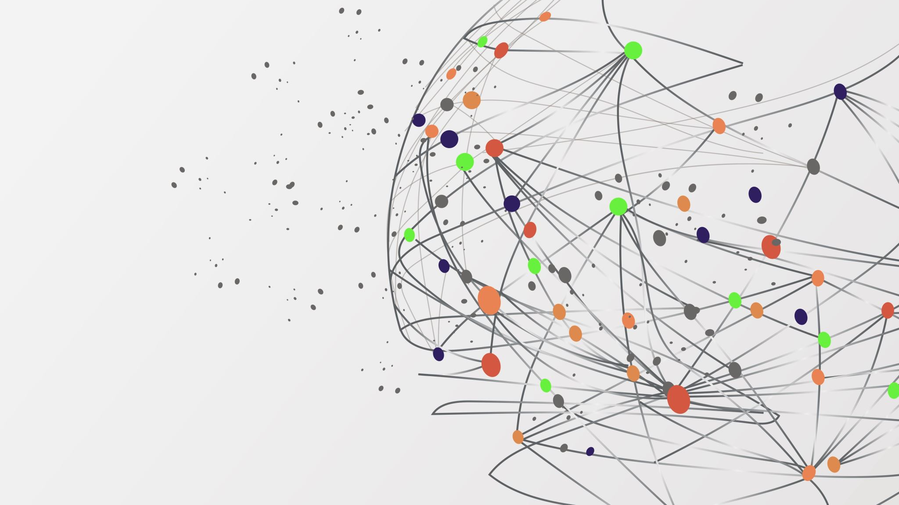
Open Discussion
SacPAS Workshop
December 6, 2023
Sacramento CA & online

Slide 2
Open Discussion
Questions
Comments
Insights
Notes:
For this session, we are looking for questions, comments and insights from all of you.

Slide 3
Revisit workshop goals & objectives
Provide stakeholders greater awareness of SacPAS tools
Streamline data management processes
Refine tools with better understanding of users’ needs
Receive requests for new tools to be developed
Notes:
To help prompt questions, here is a reminder of our goals for this workshop:
Provide stakeholders with greater awareness of SacPAS tools
Streamlining data management processes
Refine tools with better understanding of users’ needs
Receive requests for new tools to be developed
I’ll provide a few examples for each of these

Slide 4
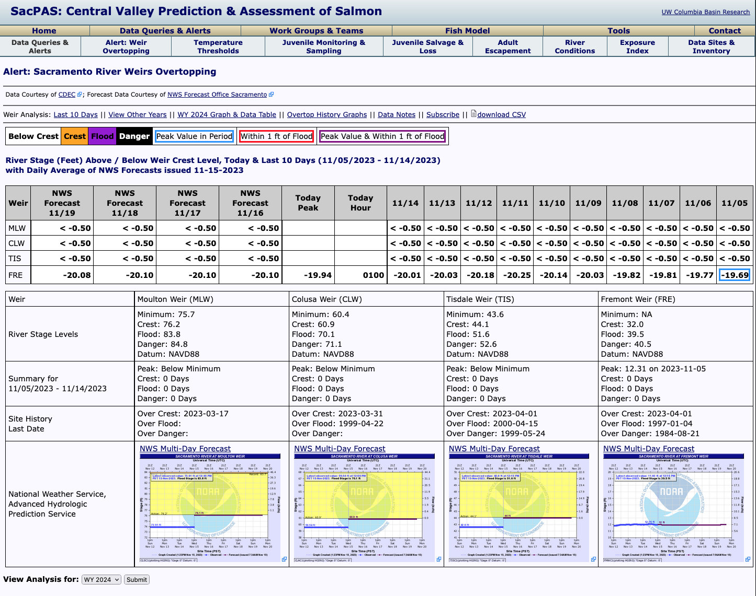
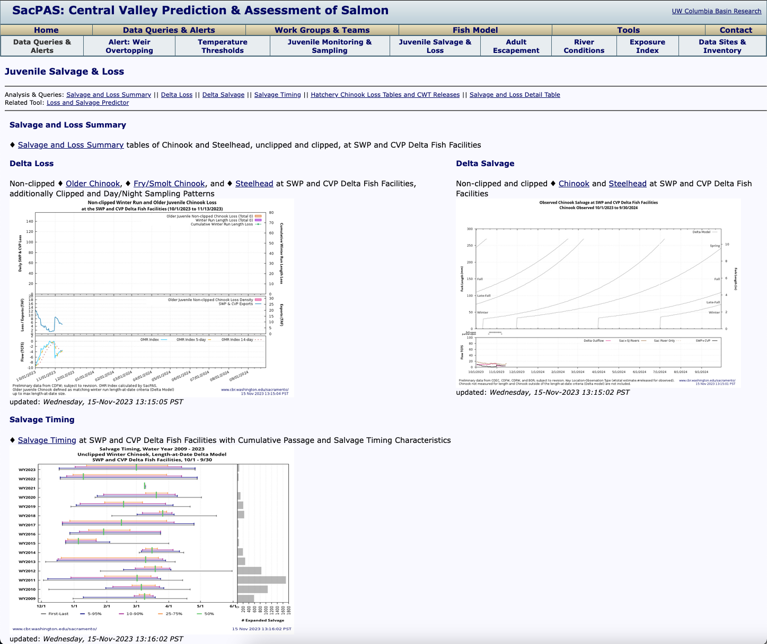
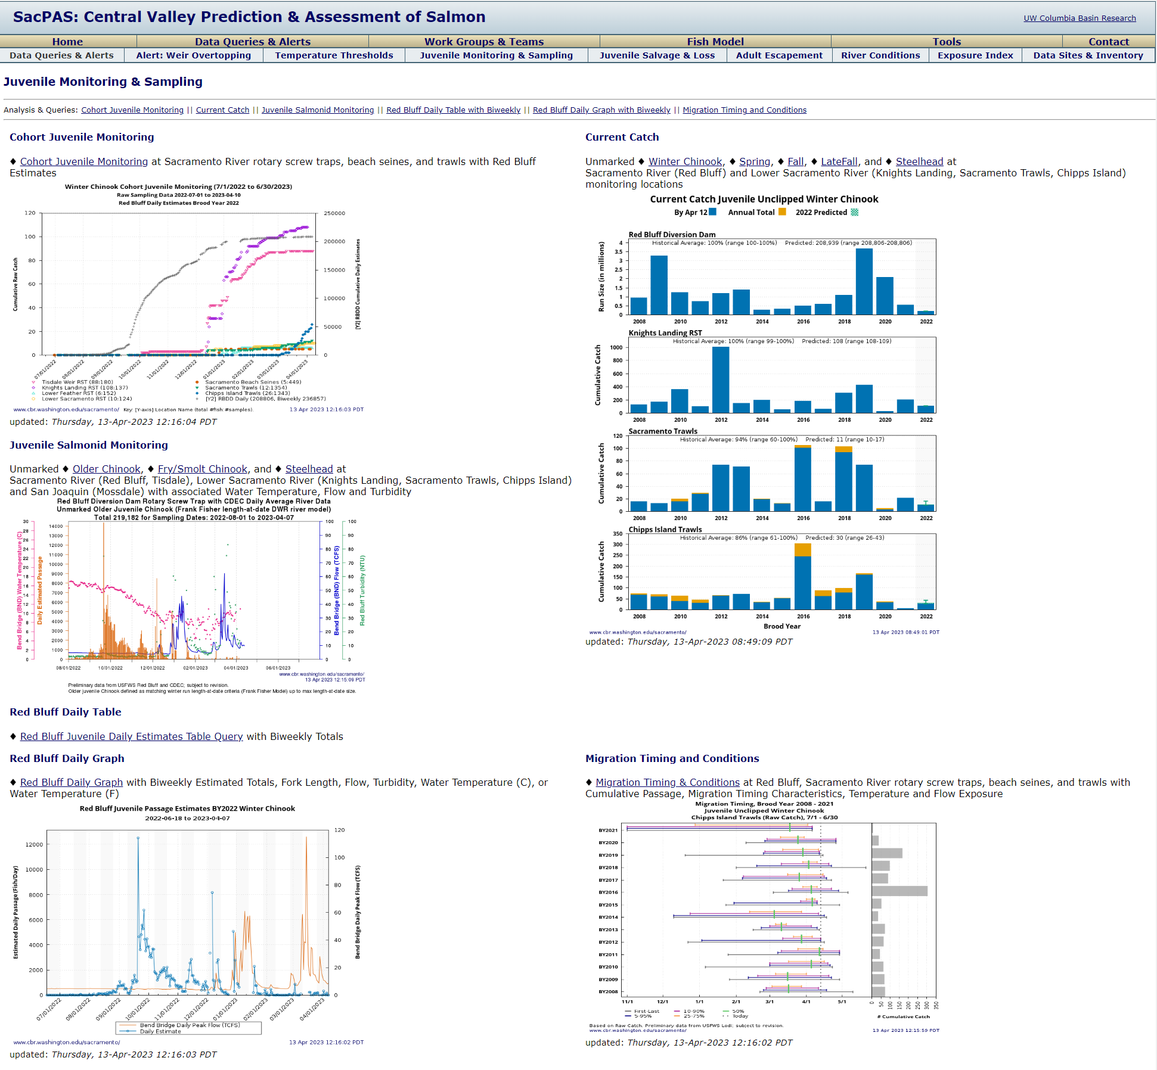
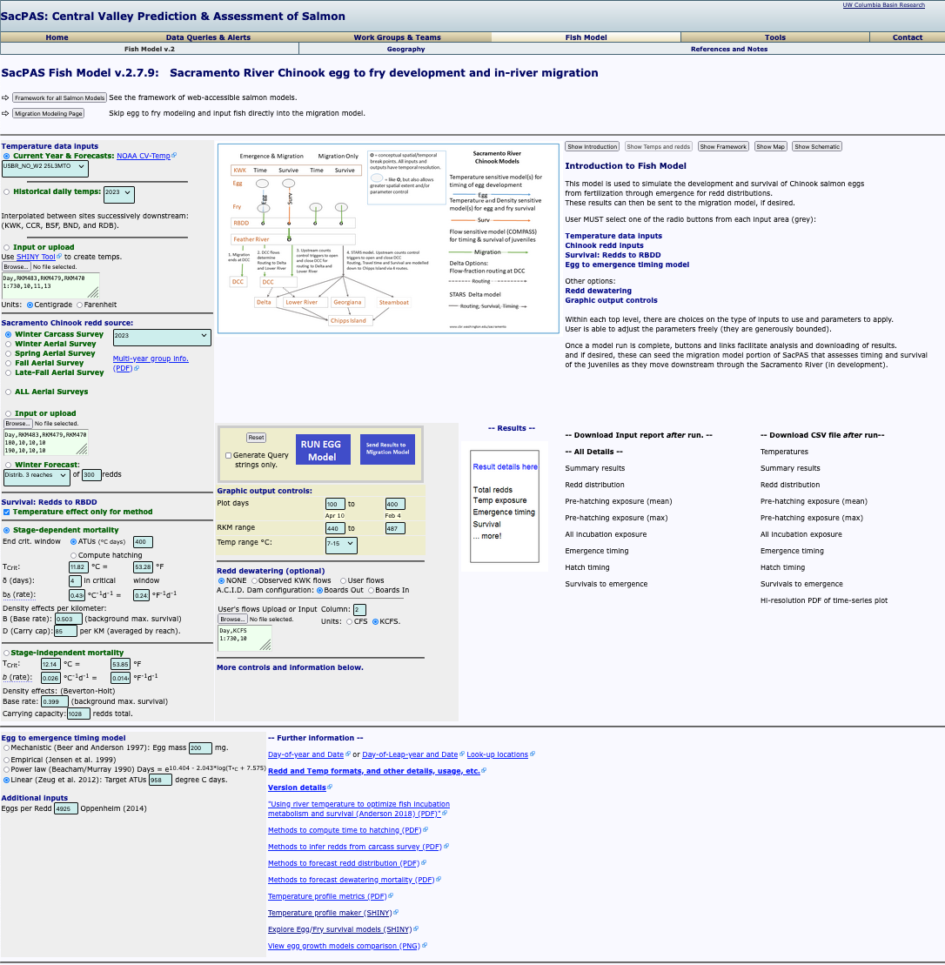
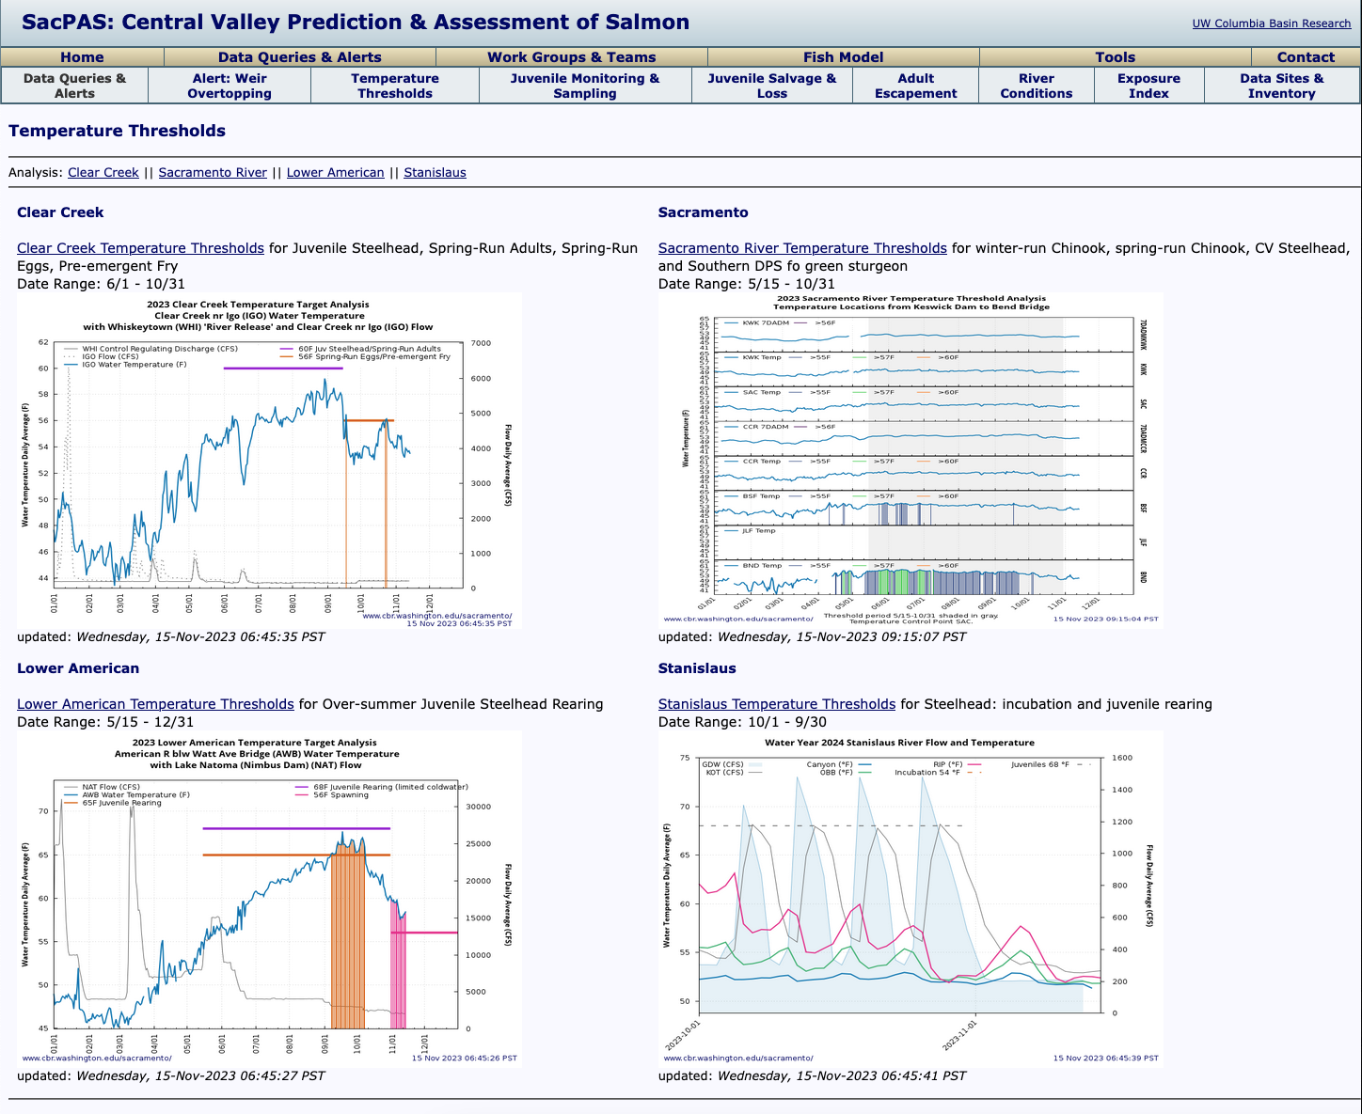
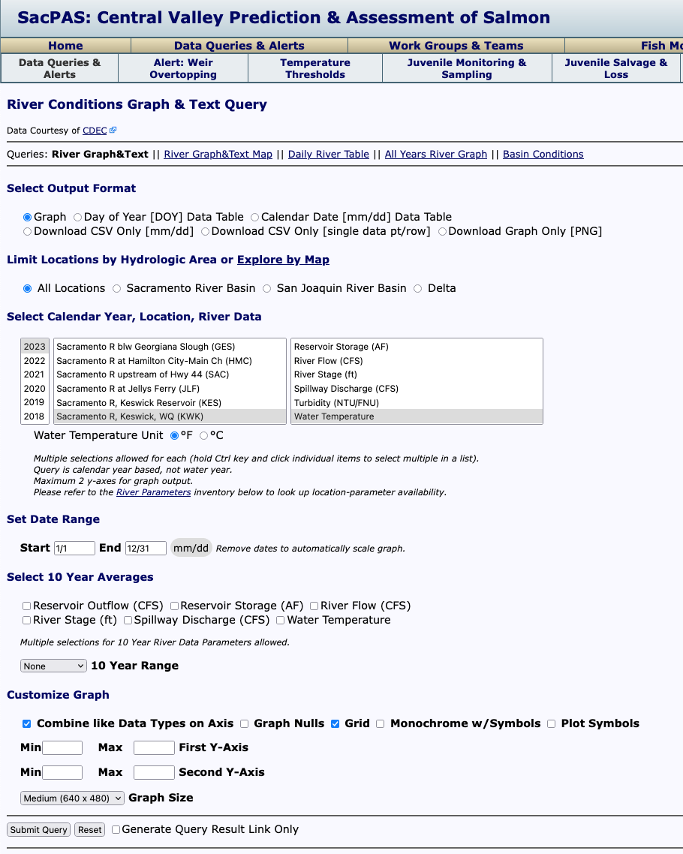
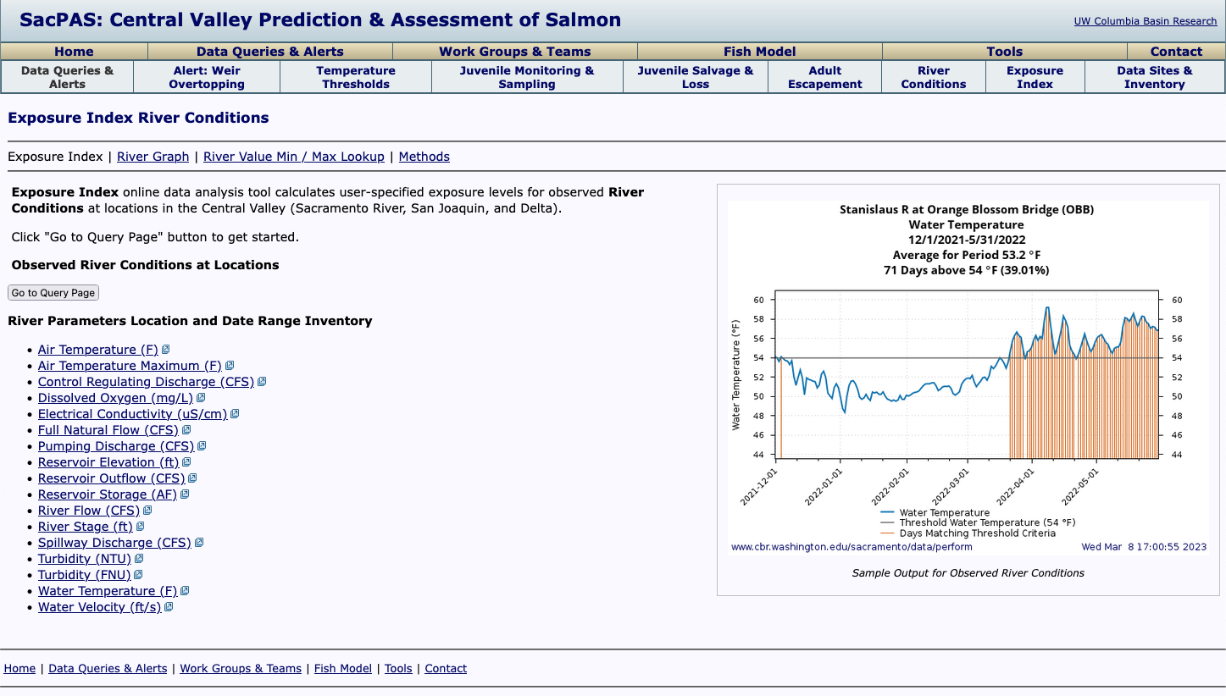
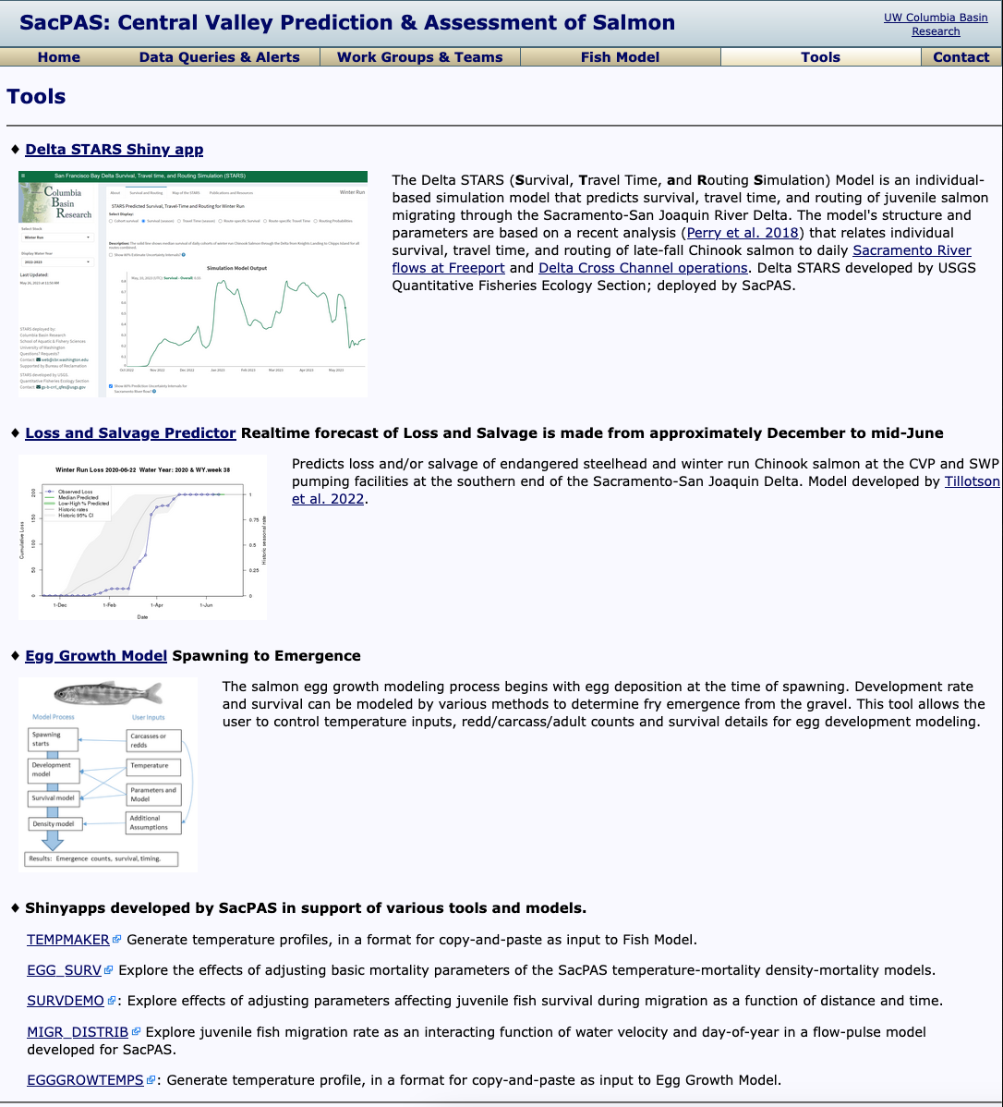
1. Provide stakeholders greater awareness of SacPAS tools
Walk through additional examples of SacPAS tools:
“Choose your own adventure”
Notes:
For providing stakeholders greater awareness of SacPAS tools, we can walk through SacPAS tools or pages in more detail. Here are a few examples including looking at
Alerts
salvage and loss tools
juvenile salmon monitoring tools
the fish model
Temperature thresholds
River conditions queries, thresholds, plots

Slide 5

2. Streamline open data & database management processes
How can we help meet your needs and bridge with your processes?
apply
salmon
salmon
Notes:
For the objective of streamlining open data and database management processes, we can
Brainstorm ideas for additional data and data queries that would be useful on SacPAS
Answer your questions about how to make your data more accessible or user friendly
Take suggestions on improving transparency and availability of data on SacPAS

Slide 6
SacPAS aims to provide online tools to help users’ specific needs
3. Refine tools with better understanding of users’ needs
Examples of users’ needs:
Planning management scenarios
Tracking performance of seasonal and annual management objectives
Providing data for real-time monitoring assessments and handouts
Notes:
For the goal of refining tools with better understanding of users’ needs, this can be applicable to
Planning management scenarios
Tracking performance of seasonal and annual management objectives
Providing data, visualizations for real-time monitoring assessments and handouts
The team would love to make existing tools more useful for these purposes, whether it is adding additional annotations on plots, adding detail for how to use tools, or on existing plots, adding additional data sources or models as selections that can be used as tools, adding additional features to tools, or compiling visualizations and tools used for a specific purpose onto a single page.

Slide 7
Handout for any
Inquiries or Requests
4. Receive requests for new tools to be developed
Step through one
as an example
Any questions?
Notes:
The team would also be excited to receive requests for new tools to be developed.
If we aren’t able to cover all requests today, please feel free to fill out the handout for any inquiries or requests.

Slide 8
Open Discussion
Walkthrough of a particular page, tool, process, metric
Datasets or specific parameters to be added
Queries to be added or edited
Visualizations to be added or edited
How to improve SacPAS usability
How to make your data more available and accessible
Suggestions for increasing SacPAS data transparency, availability
Request for edits to existing modeling tools
Request for new page with specific compilation of features
Request for new tool
Notes:
Walkthrough of a particular page, tool, process, metric
Datasets or specific parameters to be added (e.g. working on adding salmon genetics data to salvage database, and recently added 3-day averaged water temperature at Jersey Point, which is called out in the ITP for Delta Smelt and not expressly available on CDEC)
Queries to be added or edited (e.g. added a smelt query onto SMT page)
Visualizations to be added or edited (e.g. working on adding historical JPE)
User interface (e.g. any suggestions for making the website and its tools more intuitive?)
How to make your data more available and accessible
Suggestions for increasing data transparency, availability (e.g. adding notes on EDSM data to indicate whether or not it was QA/Qced)
Request for edits to existing modeling tools (e.g. recent additions to the fish model include inputting wet year water temperature data to look at patterns by wyt)
Request for new page with specific compilation of tools (e.g. recent Stanislaus watershed team page now streamlines processes for preparing SWT meeting handout)
Request for new models, tools

Slide 9
Open Discussion
What data sets/ data metrics do you think would be useful to have on SacPAS that are not there yet?
What data summaries, visualizations could you use for explaining decisions made to the public?
What tasks do you do manually that could possibly be automated?
  Why do you continue to do the tasks manually?
  (Security/ always done this way/ did not know it could be automated/ don’t know how to automate/ lack of time or resources to make it happen\ other)

Slide 10
Open Discussion
What decision do you make in which you refer to real-time data, forecasted data, and/or historical data?
Can you please describe your process and timeline so that we have a better idea?
What supportive resources would you find useful?
Manuals (PDF files)
Interactive manuals
Video tutorials
Chatting with a SacPAS team member
Time to explore the website and try queries
Workshops and shared presentations

Slide 11
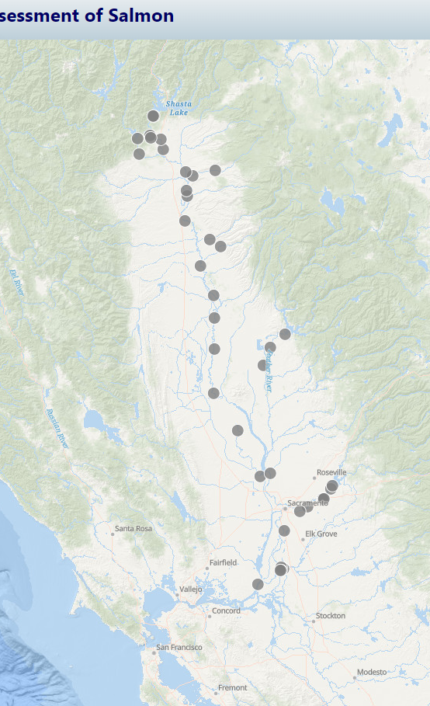
Open Discussion
Open Discussion
For folks interested in a map-based interface to a query, can you please talk through what aspects of the map you find important and useful to have? Can you describe how you are seeing and interpreting the information in reference to the map?
As an exercise, would anyone like to answer questions in the SacPAS online tool request form and explore ideas?

